Slide 1


Atlassian’s System of Work
Name goes here
Title follows
BK

Slide 2




New realities shaping work
Harnessing generative AI
Distributed team productivity
Tool & data silos
Notes:
There are a lot of new realities shaping the way we work
We hear leaders bring up these recurring themes:
There’s a lot of hype around AI. But how do we operationalize AI within our organization? How do we make use of it in our own individual contexts?
Irrespective of return to work policies, scaled companies have to contend with distributed teams - How do we keep them effective in a remote, in person or hybrid world?
And the sprawl of tools and data is a constant battling against siloes. How do we rationalize our technology stack and ensure our organization can work together easily?

Slide 3
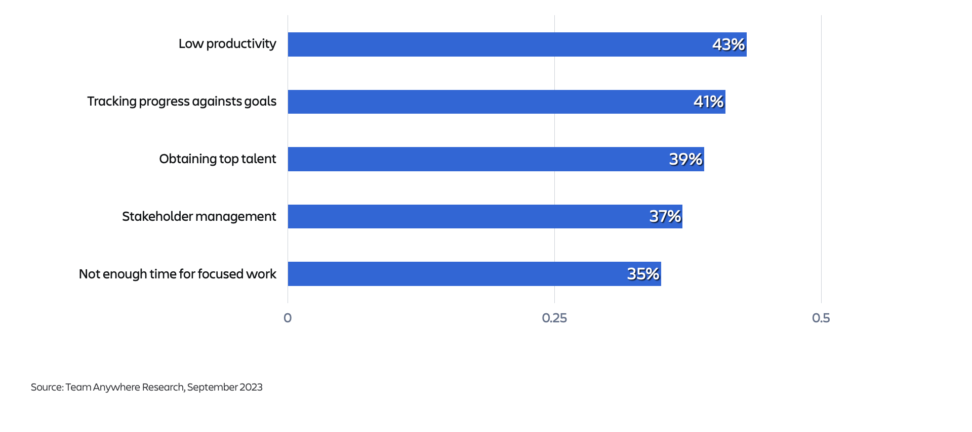
TEAM ANYWHERE | RESEARCH
Top Organizational Challenges
Notes:
According to our own Team Anywhere research, Fortune 1000 executives highlight the following as their top organizational challenges.
At the very top is low productivity. A lack of alignment to goals is a very close second. And only a few percentage points behind that is stakeholder management, which gets right at the heart of effective collaboration.
It’s clear that many organizations continue to struggle with the foundational aspects of teamwork.
Atlassian can help enterprise customers address these critical and foundational aspects of teamwork and collaboration.

Slide 4
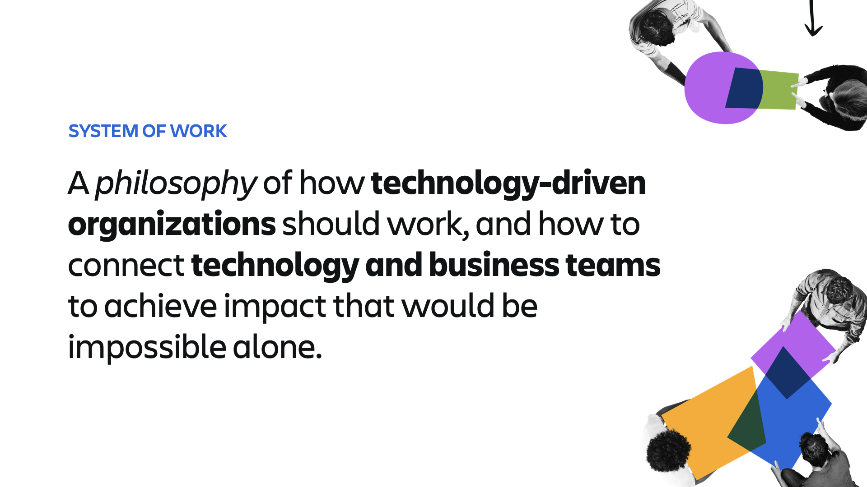
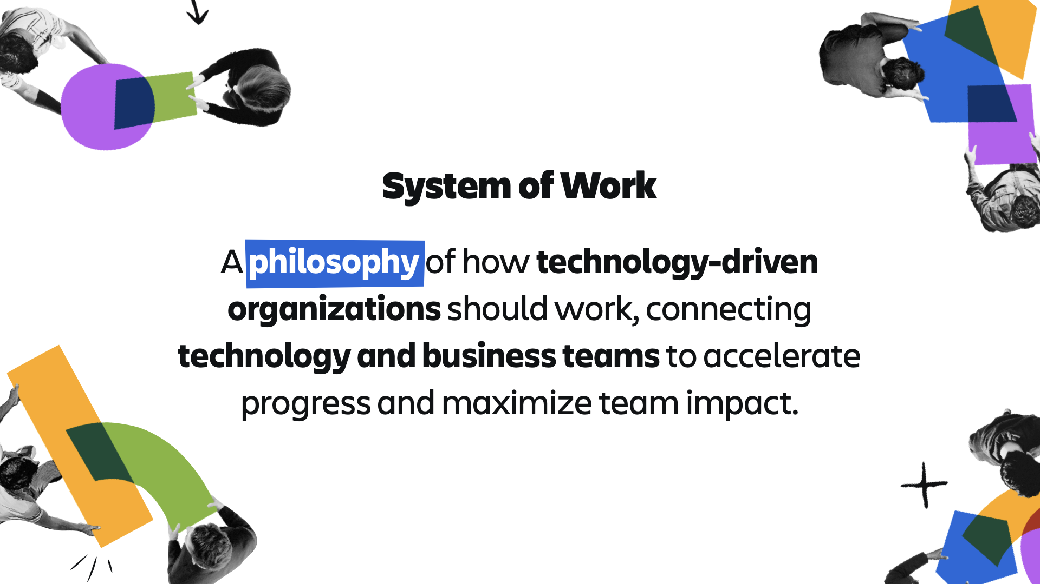
System of Work
A philosophy of how technology-driven organizations should work, connecting technology and business teams to accelerate progress and maximize team impact.
Notes:
We call it: The System of Work.
The System of Work is our philosophy of how technology-driven organizations should work, connecting technology and business teams to accelerate progress and maximize team impact.
So what is a technology-driven organization? It’s those companies who believe technology is on their critical path to success, whether they are building software, undergoing a digital transformation, or launching new innovations.

Slide 5
Marketing teams
Leadership teams
Influenced pipeline
Sales qualified leads (SQLs)
Funnel conversion rates
Social media engagement
Net promoter score (NPS)
Revenue growth
Profit margins
Customer acquisition cost
Operating cash flow
Client retention rate
Sales teams
HR teams
Bookings
Sales cycle length
Quota performance
Lead response times
Customer retention
Cost per hire
Employee engagement
Turnover rate
Employee satisfaction
Time to hire
Product teams
Time to market
Customer retention rate
Customer lifetime value
Team velocity
Customer acquisition costs
Dev teams
Development velocity
Cycle time
Code coverage
Deployment frequency
Code churn
Sprint burndown
Lead time
IT teams
Uptime / availability
Cybersecurity incidents
Resolution time
Service levels
Open support tickets

Slide 6
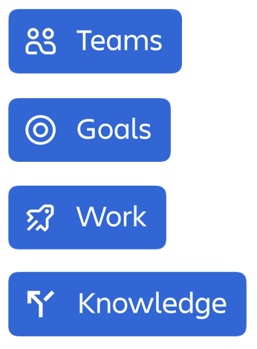
System of Work Principles
All
Align work to
Plan & track
Unleash collective
Notes:
So how do you bring technology and business teams together and build a system of work across your org? We believe in three key principles:
Align work to shared goals → When all work aligns to goals and all goals are visible across all teams in an entire organization, companies focus on the right things.
Plan and track work together → When every team has a shared understanding of the who, what, when and how behind work, progress is inevitable.
Unleash collective knowledge → Knowledge is everywhere, yet nowhere. When teams can build, share and harness their collective knowledge, they can achieve collective growth.
These principles form a system of work for how your teams can work - and work across technology and business teams - to orchestrate all the moving parts of your tech-driven business.
Atlassian’s portfolio delivers the products as well as the practices that drive specific behaviors that can bring your tech and business teams together.

Slide 7
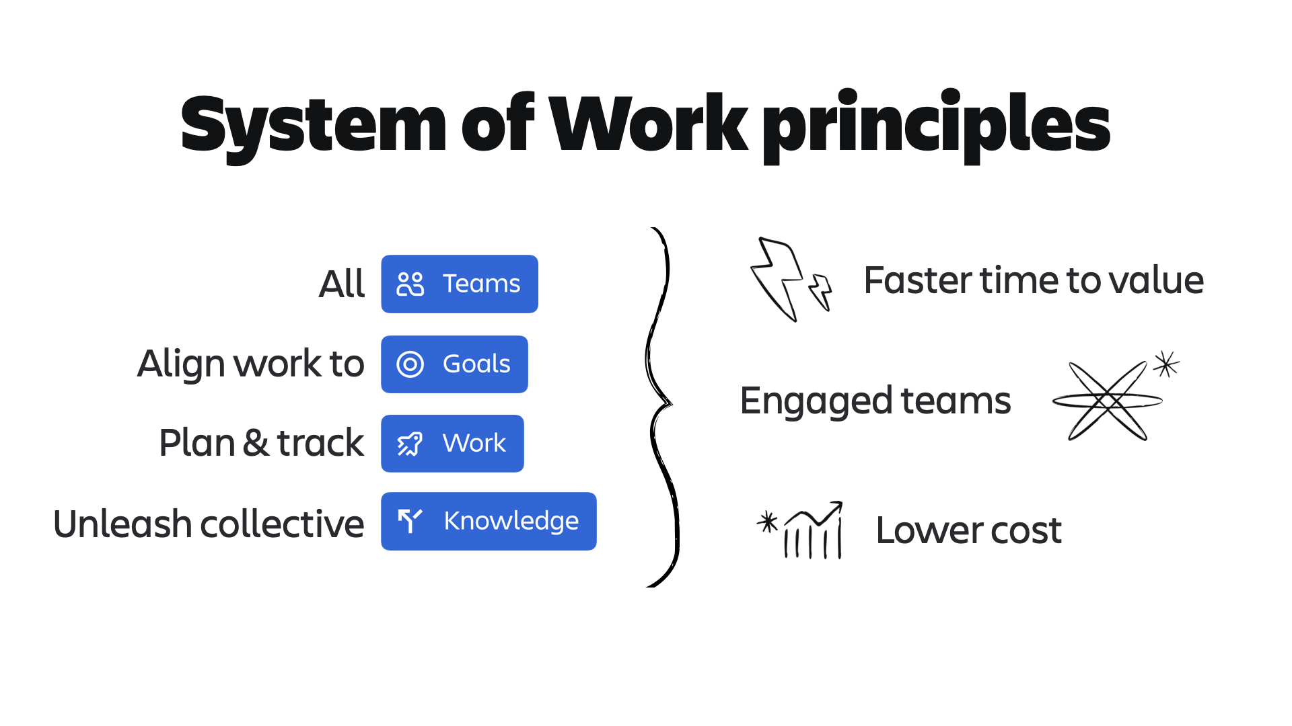
System of Work Principles
All
Faster time to value
Align work to
Engaged teams
Plan & track
Unleash collective
Higher ROI
Notes:
When you do this consistently, you’ll observe faster time to value, more engaged teams and higher return on investment.

Slide 8
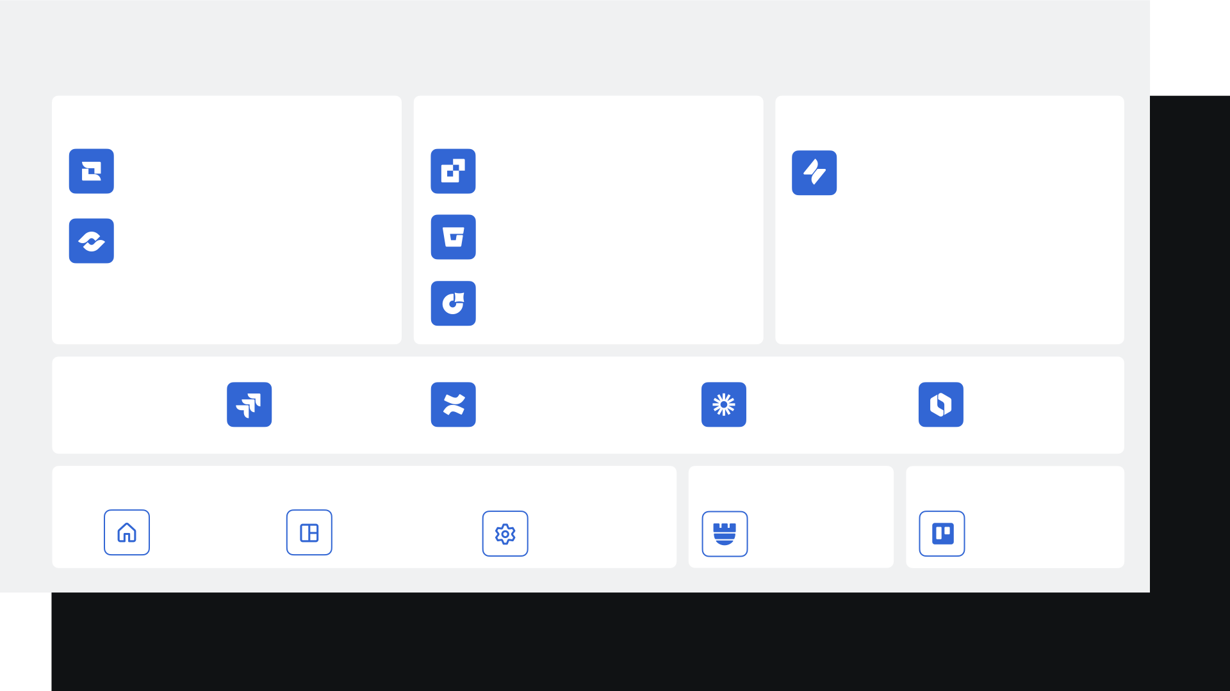
Atlassian Portfolio for System of Work
LEADERSHIP TEAMS
SOFTWARE TEAMS
IT TEAMS
Jira Align
Compass
Jira Service Management
Focus
Bitbucket
Jira Product Discovery
Teamwork Foundation
ALL TEAMS
Jira
Confluence
Loom
Rovo
GLOBAL APPS
SECURITY
PERSONAL PRODUCTIVITY
Home
Analytics
Admin Hub
Guard
Trello
Atlassian Cloud Platform
Notes:
To implement this system that brings teams together, we have built a portfolio of products…
With foundational products like Jira, Confluence, Loom and now Rovo that every team, every knowledge worker should have
And specialized products for software, IT and leadership teams
We’ve designed global apps like Atlassian Home, Analytics, and Admin Hub to serve as central hubs across our platform.
And depending on your particular needs, we’ve got Guard for added security requirements, and Trello which is designed for personal productivity.

Slide 9
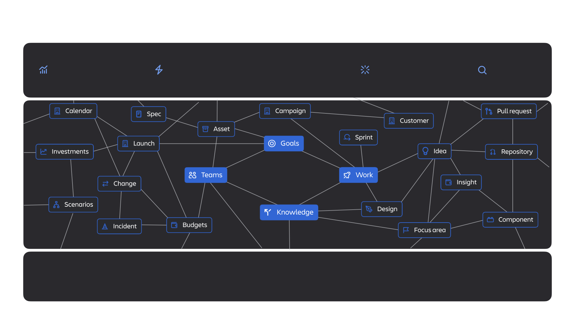
Atlassian Cloud Platform
Data visualization
Automation
Experiences
Atlassian Intelligence
Search
Teamwork graph
Enterprise Infrastructure
Notes:
Our entire portfolio is supported by a powerful cloud platform.
At the core of our platform is our Teamwork Graph - a very special data layer that captures the building blocks of all that teamwork. The Teamwork Graph captures your teams, their work, their goals and their knowledge
Teamwork graph establishes the connections between these key building blocks in your organization. And that is a goldmine for Teamwork AI.
The teamwork graph is the pulsing heart of the Atlassian Cloud Platform and powers experiences like AI, search and automation across all Atlassian products. It is the reason we are able to run experiences like unified search and automation…..
This portfolio is powered by the Atlassian Cloud platform built on our enterprise-infrastructure layer - with performance, scale, reliability, compliance, privacy, and security.
At the core of our platform is our Teamwork Graph - a very special data layer that captures the building blocks of all that teamwork. The Teamwork Graph establishes the connections between your teams, their work, their goals and their knowledge.
The teamwork graph powers experiences like AI, search and automation across all Atlassian products. It is the reason we are able to run experiences like unified search and automation
But we don’t believe all your problems can be solved by one vendor alone. That why the teamwork graph isn’t just across Atlassian products…

Slide 10
“
55% of IT leaders say that the requirements for successful generative AI use include accurate, complete, and unified data
CIO
“Is your data strategy ready for gen AI? LOB leaders may disagree,” Nov 2, 2023
Notes:
We all know AI is a top priority, if not the #1 priority, for most organizations today. Leaders are all looking at ways to operationalize AI to benefit their business. However, most leaders cite that data quality & harmonization are business critical to how effective AI will be, and many leaders are asking whether their data strategy is ready.
IT leaders say that the requirements for successful gen AI use include accurate, complete, and unified data (55%)
AI is only as good as the data it draws from
with all your data, work, strategies, decisions, etc in one place that gives AI a centralized super-rich source of data to draw from.

Slide 11
Leadership teams
Marketing teams
Sales teams
Product teams
Dev teams
IT teams
HR teams

Slide 12
Teamwork Foundation
The only collaborative work foundation designed to unite all teams across the whole organization.

Slide 13
Too much is at stake
to keep working the way we’ve been working.

Slide 14
Orgs with high levels of cross-functional alignment report higher revenue growth.
Forrester
Orgs with high levels of collaboration drag are 37% less likely to achieve revenue goals.
Gartner
Notes:
First, organizations with high levels of cross-functional alignment report higher revenue growth than companies without. This makes sense right?! Conversely, organizations with high levels of collaboration drag (defined as too much complexity and process bloat) are 37% less likely to hit their revenue target. This also makes sense right?
What’s clear is that organizations that can improve cross-functional alignment of teams and reduce the collaboration drag that slows them down will be best positioned to meet their revenue growth goals should.
Now how does IT fit in here? IT teams and the IT function in general are at a critical juncture. CIOs look to unlock revenue growth through technology innovation and by focusing on improving both customer and employee experiences. However, a number of headwinds hold them back from delivering the outcomes they need.

Slide 15



ATLASSIAN | THREE QUESTIONS TO REFLECT ON
Three questions:
…the things that really move the needle for the business!
Are teams working on the right things?
Do we have the right context to make decisions?
How do we get teams to collaborate more effectively?
…so they can help the business get to value faster, without burning out!
…decisions that will move the business forward!

Slide 16






Organizations struggle to nurture effective teamwork
ATLASSIAN | BUSINESS CHALLENGES
Business Challenges
Goal alignment and communication
High costs and overhead
Missed deadlines or exceeding budgets
Unnecessary and unsustainable risks
Lack information to make decisions

Slide 17
Overcome major business challenges and nurture effective teamwork with better work practices
ATLASSIAN | OVERCOMING BUSINESS CHALLENGES WITH BETTER PRACTICES
Goal alignment and communication
High costs and overhead
Missed deadlines or exceeding budgets
Unnecessary and unsustainable risks
Lack information to make decisions
Create and evolve high quality goals
Use goals to set priorities and align work
Make goals and regular progress updates visible
Consolidate redundant tools, standardize across teams
Standardize work hierarchy, unify and integrate project planning and tracking
Define clear R&Rs and dependencies
Break projects into tasks and milestones and make it visible
Use iterative processes to move fast
Implement security and data controls
Detect and respond to suspicious activity and data misuse
Effective change management
Share information async
Content quality over quantity
Use AI to manage and discover knowledge

Slide 18
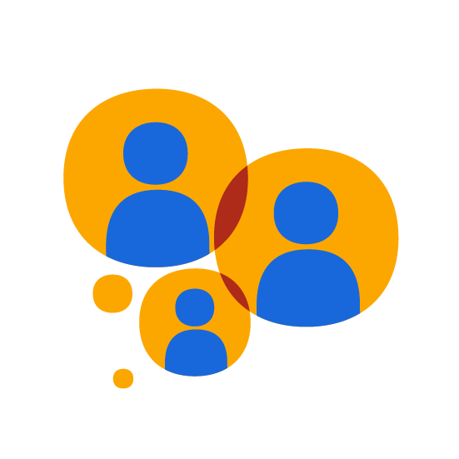
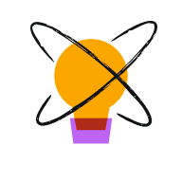

Build the foundation
for the new way of work
Free your people from excess tools and meetings. Save a ton of money too.
Focus teams on what matters. Move faster in the right direction.
Give teams autonomy to innovate. Empower outcomes, not box checking.
Unite teams
Get to value faster
Inspire innovation
Atlassian Teamwork Foundation

Slide 19
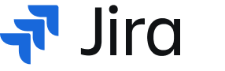
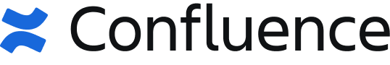


THE TEAMWORK FOUNDATION | EFFECTIVE COLLABORATION FOR THE WHOLE ORG
Unite teams
Get to value faster
Inspire innovation
Powered by
*
The foundation for effective collaborative work
Teamwork Collection
* Rovo (free) included, but Rovo Enterprise must be purchased separately from Teamwork Collection

Slide 20
THE TEAMWORK FOUNDATION | EFFECTIVE COLLABORATION FOR THE WHOLE ORG
Unify your teams’ efforts for enhanced planning and insights, seamless collaboration, and flexible workflows while scaling from simple tasks to complex projects.
Enhance visibility, simplify knowledge management, and motivate efficient cross-team collaboration and content sharing with the power of AI.
Improve communication and collaboration through personal video interactions and async information sharing that integrates seamlessly across platforms.
Leverage AI to enhance teamwork by providing connected insights, and streamlining workflows that enable teams to focus on strategic work and boost productivity and innovation.
Powered by
*
The foundation for effective collaborative work
Teamwork Collection
* Rovo (free) included, but Rovo Enterprise must be purchased separately from Teamwork Collection

Slide 21
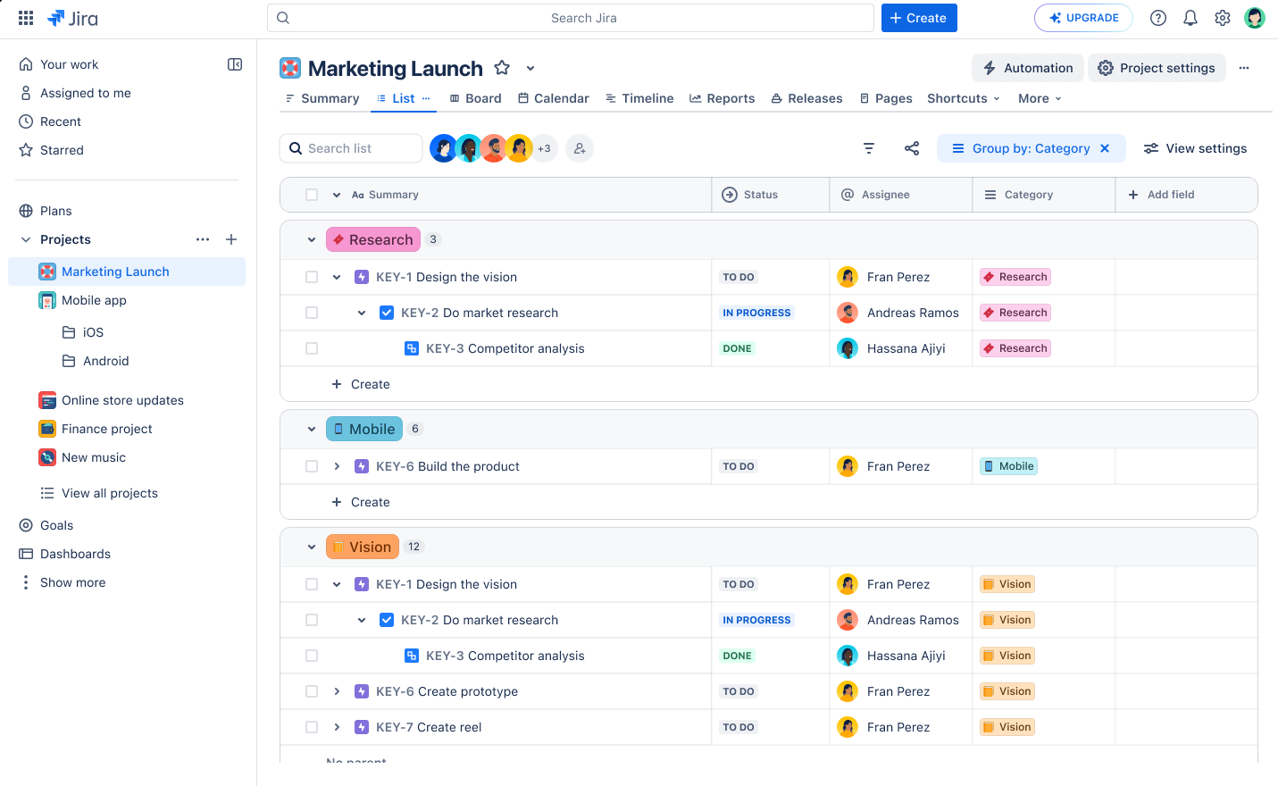
JIRA | PLAN AND EXECUTE WORK ACROSS ALL TEAMS
Designed for ALL TEAMS to collaborate
Connect planning and execution to goals at every level
Collaborate seamlessly across all teams
Gain visibility up, down, and across the organization
Increase productivity with AI and automation

Slide 22
CONFLUENCE | CREATE, SHARE, MANAGE, & DISCOVER KNOWLEDGE
Create with flexibility. Databases, whiteboards, pages, smart links
Motivate sharing. Page insights, engagement, public links, AI + automation
Discover what you need. Dynamic hub for your org, AI-assisted powerful search

Slide 23
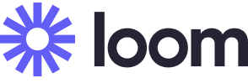
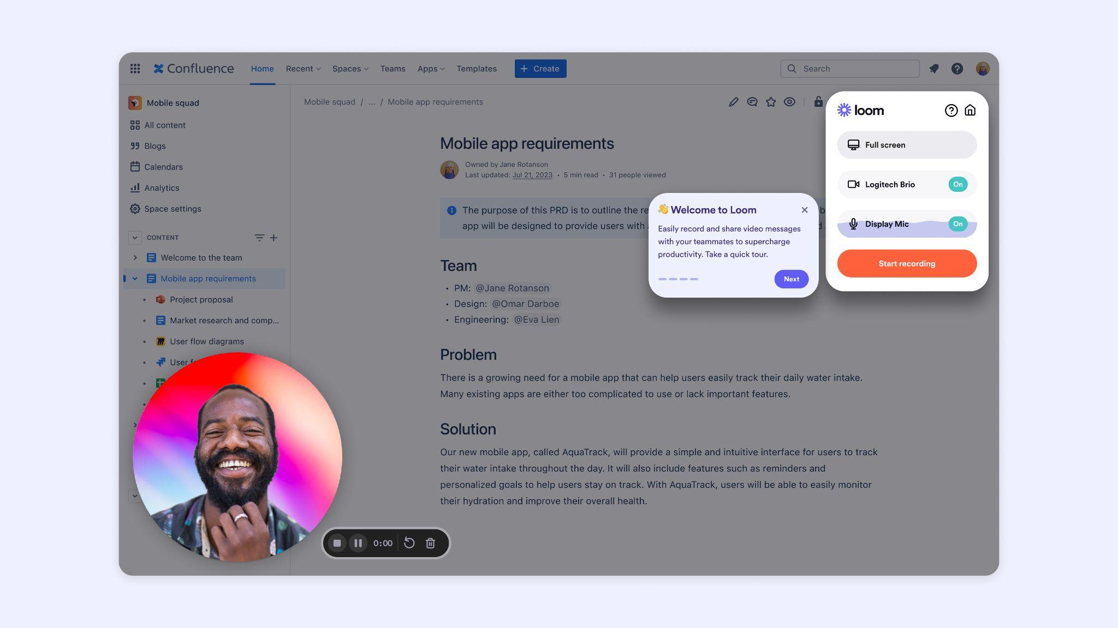
LOOM | GET MORE DONE FASTER WITH ASYNC VIDEO
Improve “distributed work” experience
Reduce meetings
Complete projects faster
Boost individual and team efficiency
Increase team connectedness
Higher prospecting response rates

Slide 24
ROVO | GEN-AI TEAMWORK ASSISTANCE
I’ve been on vacation for two weeks — please catch me up on progress my team has made that will impact our upcoming campaign
Your team finished a sprint, completed epic EPIC-123, and closed three bugs
OTHER AI TOOLS
Notes:
Many GenAI tools can - Jira.
<CLICK> so when you ask
Your team finished a sprint, completed an epic and closed 3 bugs.

Slide 25

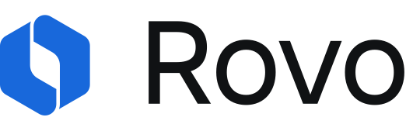
ROVO | GEN-AI TEAMWORK ASSISTANCE
Your product team decided to exclude the ‘Overseer’ persona from the first milestone, change the ship date, and completed research that found the Automation feature is the strongest value proposition
I’ve been on vacation for two weeks — please catch me up on progress my team has made that will impact our upcoming campaign
POWERED BY TEAMWORK GRAPH
Notes:
But, when you ask Rovo
Because Rovo relies
<CLICK> In comparison, Rovo knows
This is a simple example

Slide 26
TEAMWORK COLLECTION | EARLY ACCESS PROGRAM (EAP)
$25
per user per month billed annually; includes Enterprise Editions of Jira, Confluence, and Loom
$19
per user per month billed annually; includes Premium Editions of Jira, Confluence, and Loom
EAP Pricing for TWC Enterprise at 1,000 users
EAP Pricing for TWC Premium at 1,000 users
Powered by
*
The foundation for effective collaborative work
Teamwork Collection

Slide 27
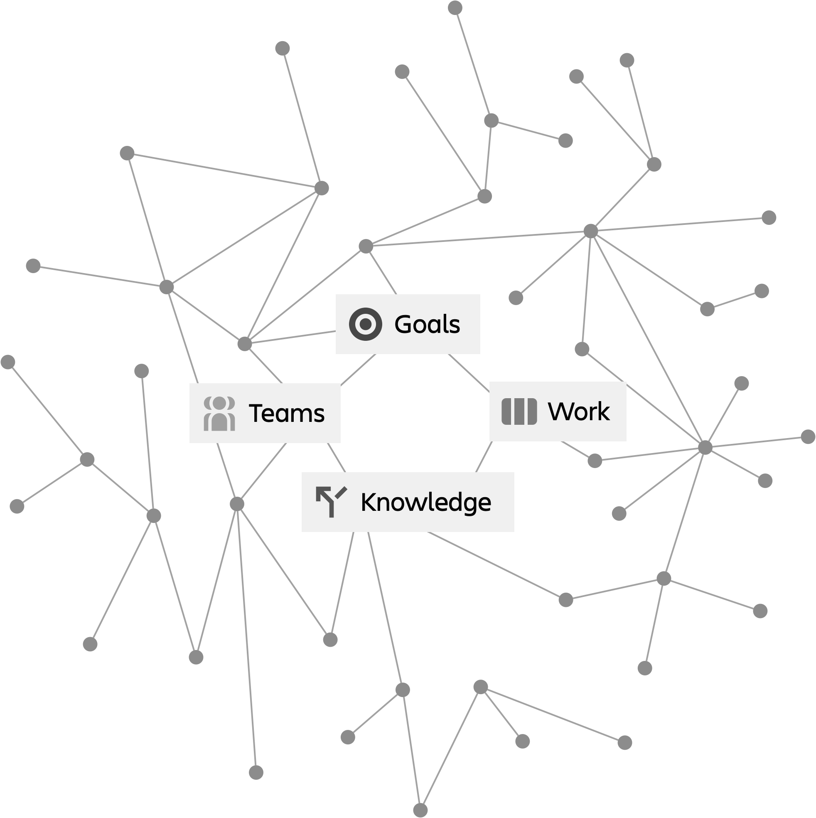
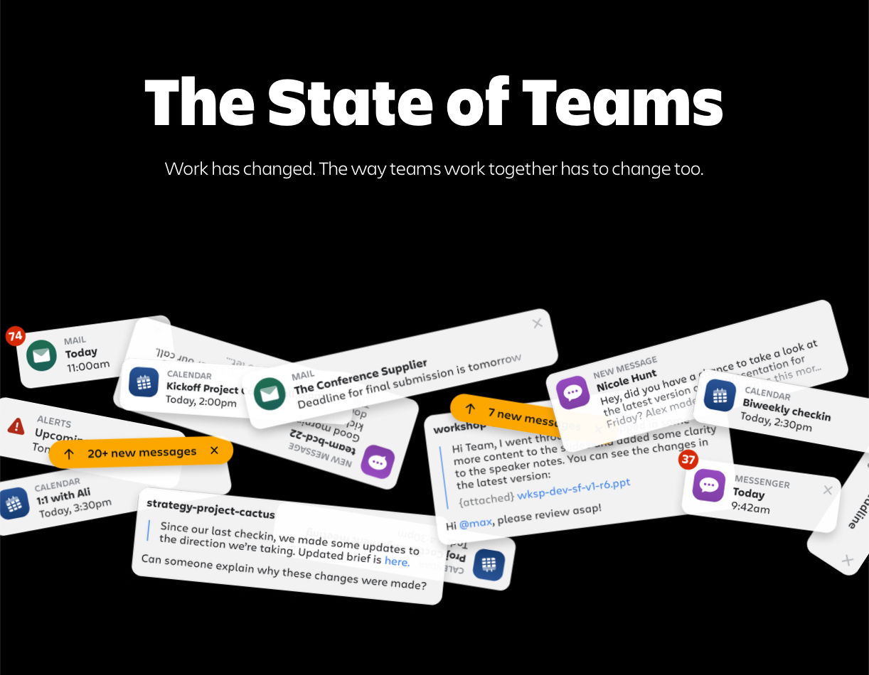
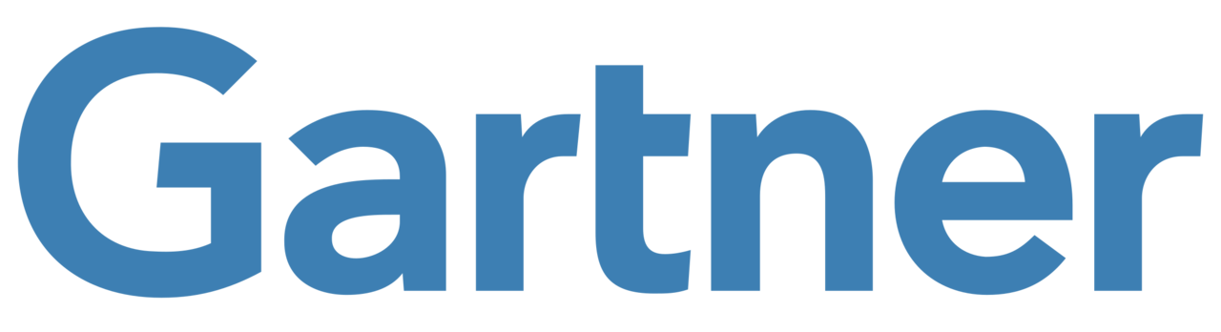
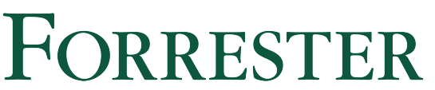
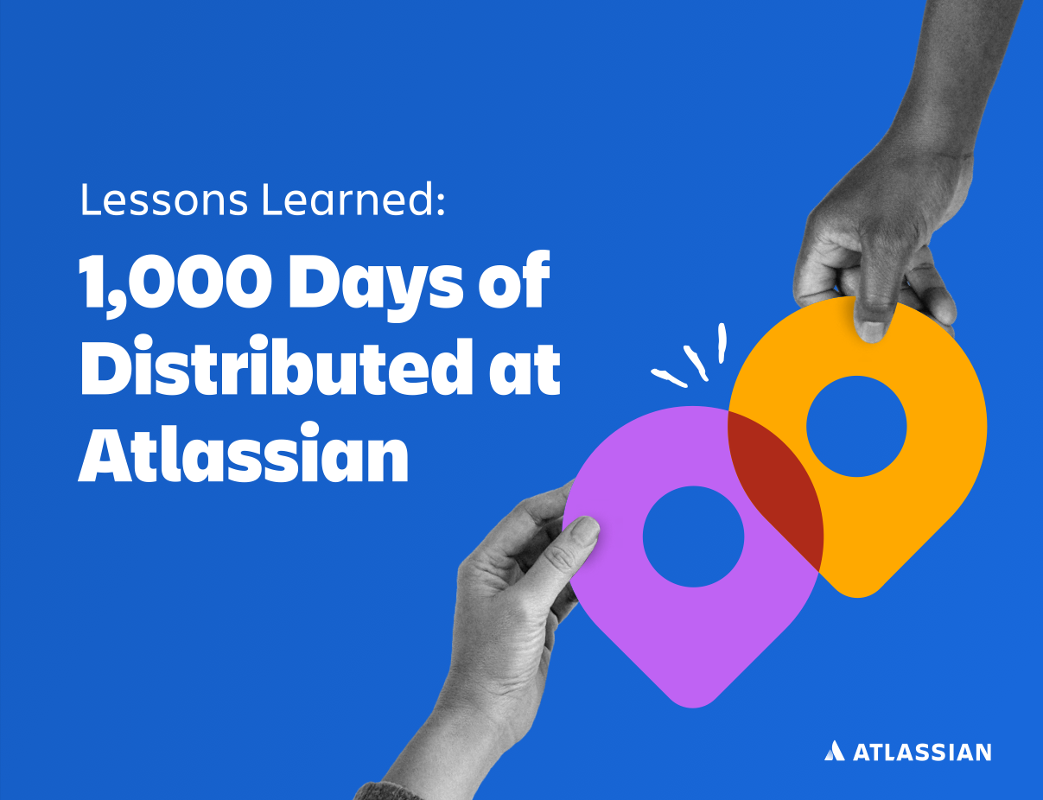
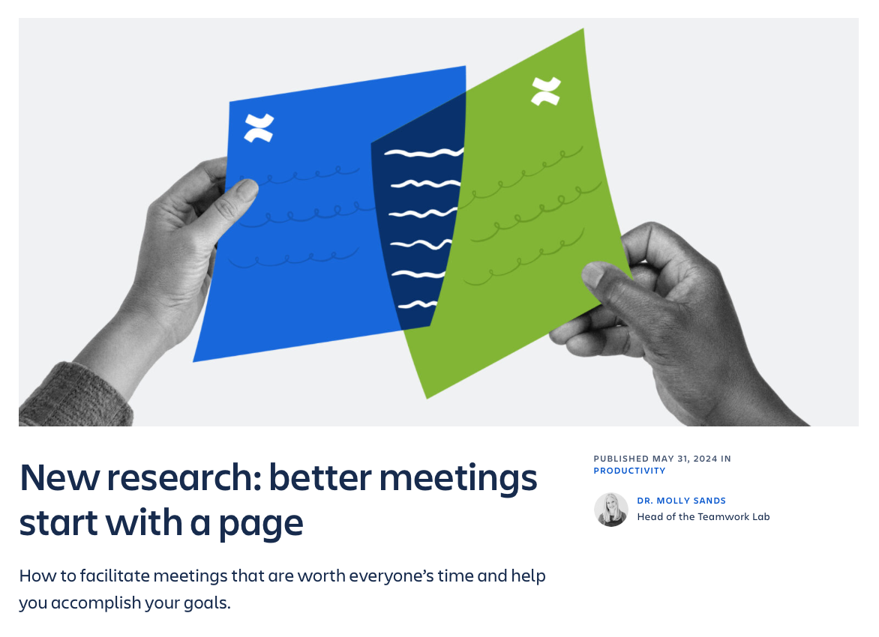
ATLASSIAN SYSTEM OF WORK | WHY BET ON US?
Why Atlassian?
THE EXPERIENCE
THE PORTFOLIO
THE PLATFORM
We’ve spent 23+ years studying the art and science of teams and how they work best to drive impact.
We’ve translated that learning into a set of products indispensable to every tech-forward company today.
We’ve built a platform powered by a Teamwork Graph that no other company can duplicate.
LEADER
LEADER
2024 Magic Quadrant™
for Marketing Work Management
2024 Wave™
for Knowledge Management
2023 Magic Quadrant™ for DevOps Platforms
2023 Wave™
for Enterprise Service Management
2022 Magic Quadrant™ for ITSM Platforms
2022 Magic Quadrant™
for Enterprise Agile Planning
Notes:
So why trust Atlassian to build your organizations system of work? We believe we have the best SoW implementation for technology-driven companies.
#1 — Our experience: We’ve spent the last 23 years studying how high-performing teams and organizations work best. We use that experience to inform both work practices and products that help organizations work faster and more effectively
#2 — Our portfolio: Our portfolio of products, informed by our experience, empowers technology and business teams as they navigate across different jobs to be done while always having the right context and visibility.
#3 — Our platform: Our connected platform connects your teams and tools, and provides powerful and context-rich experiences across the portfolio.

Slide 28
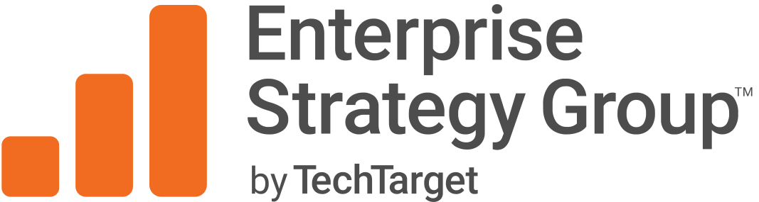
When it works
40%
75%
35%
faster time to value
up from 57% project success
reduced interruptions
Report: Analyzing the Economic Benefits of Improving Work Management with Atlassian
Notes:
Using our solutions customers have seen:
More efficiency: 40% faster time to value
Increased effectiveness: Increase of project success from 57% to 75% (by aligning workflows to output)
And higher productivity: Decreased interruptions by 35%
This is not just what we say - our research with ESG an independent research company supports this too
As your partners, our success is anchored on yours, and our goal is to not just drive positive change, but real impact across your business.

Slide 29
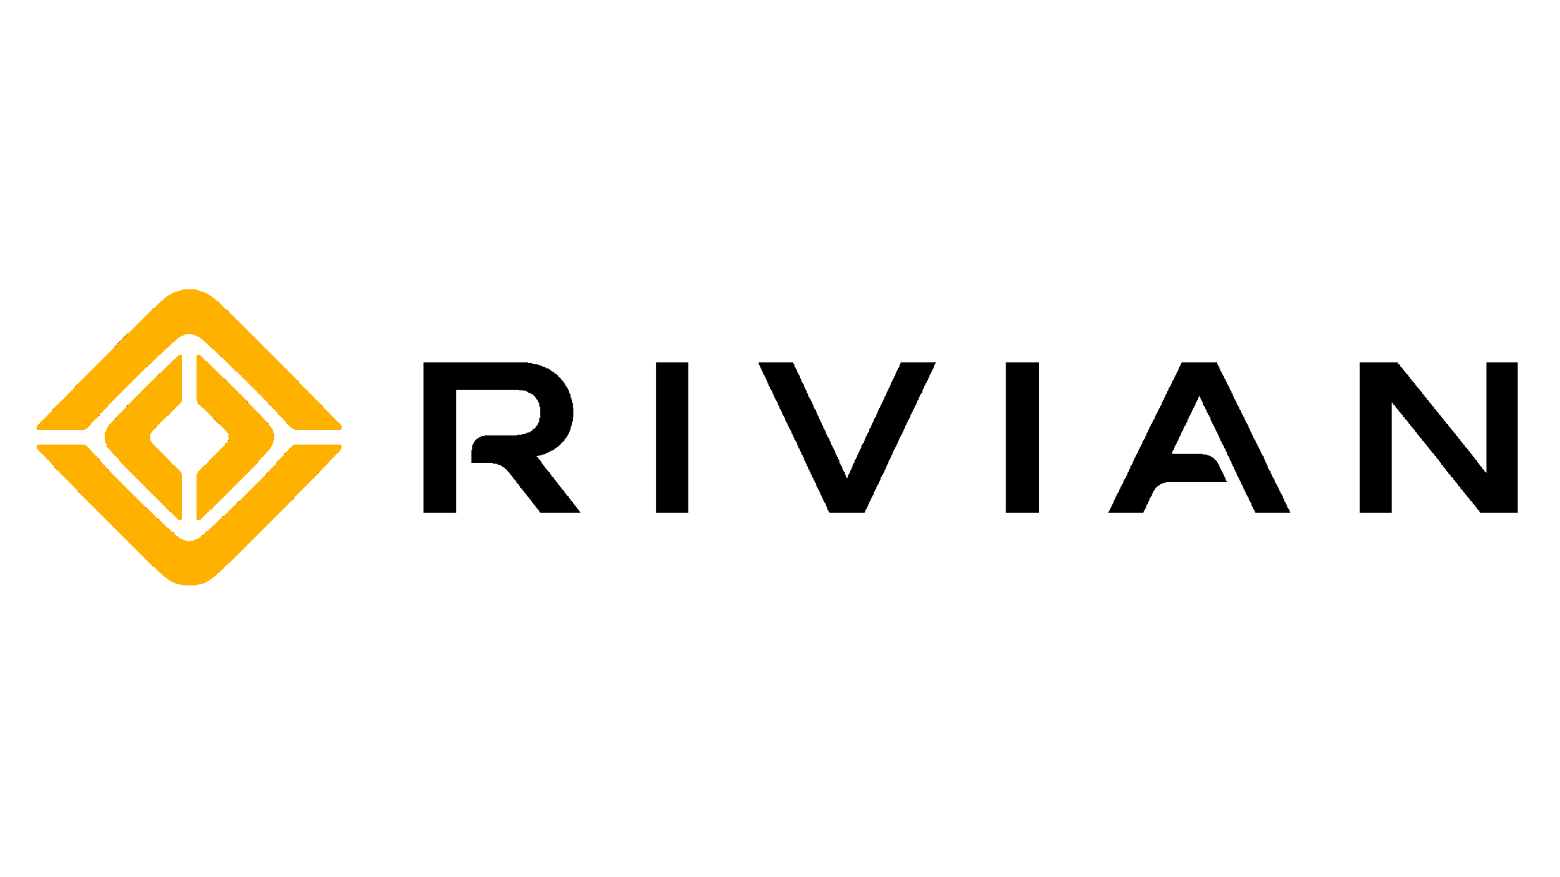
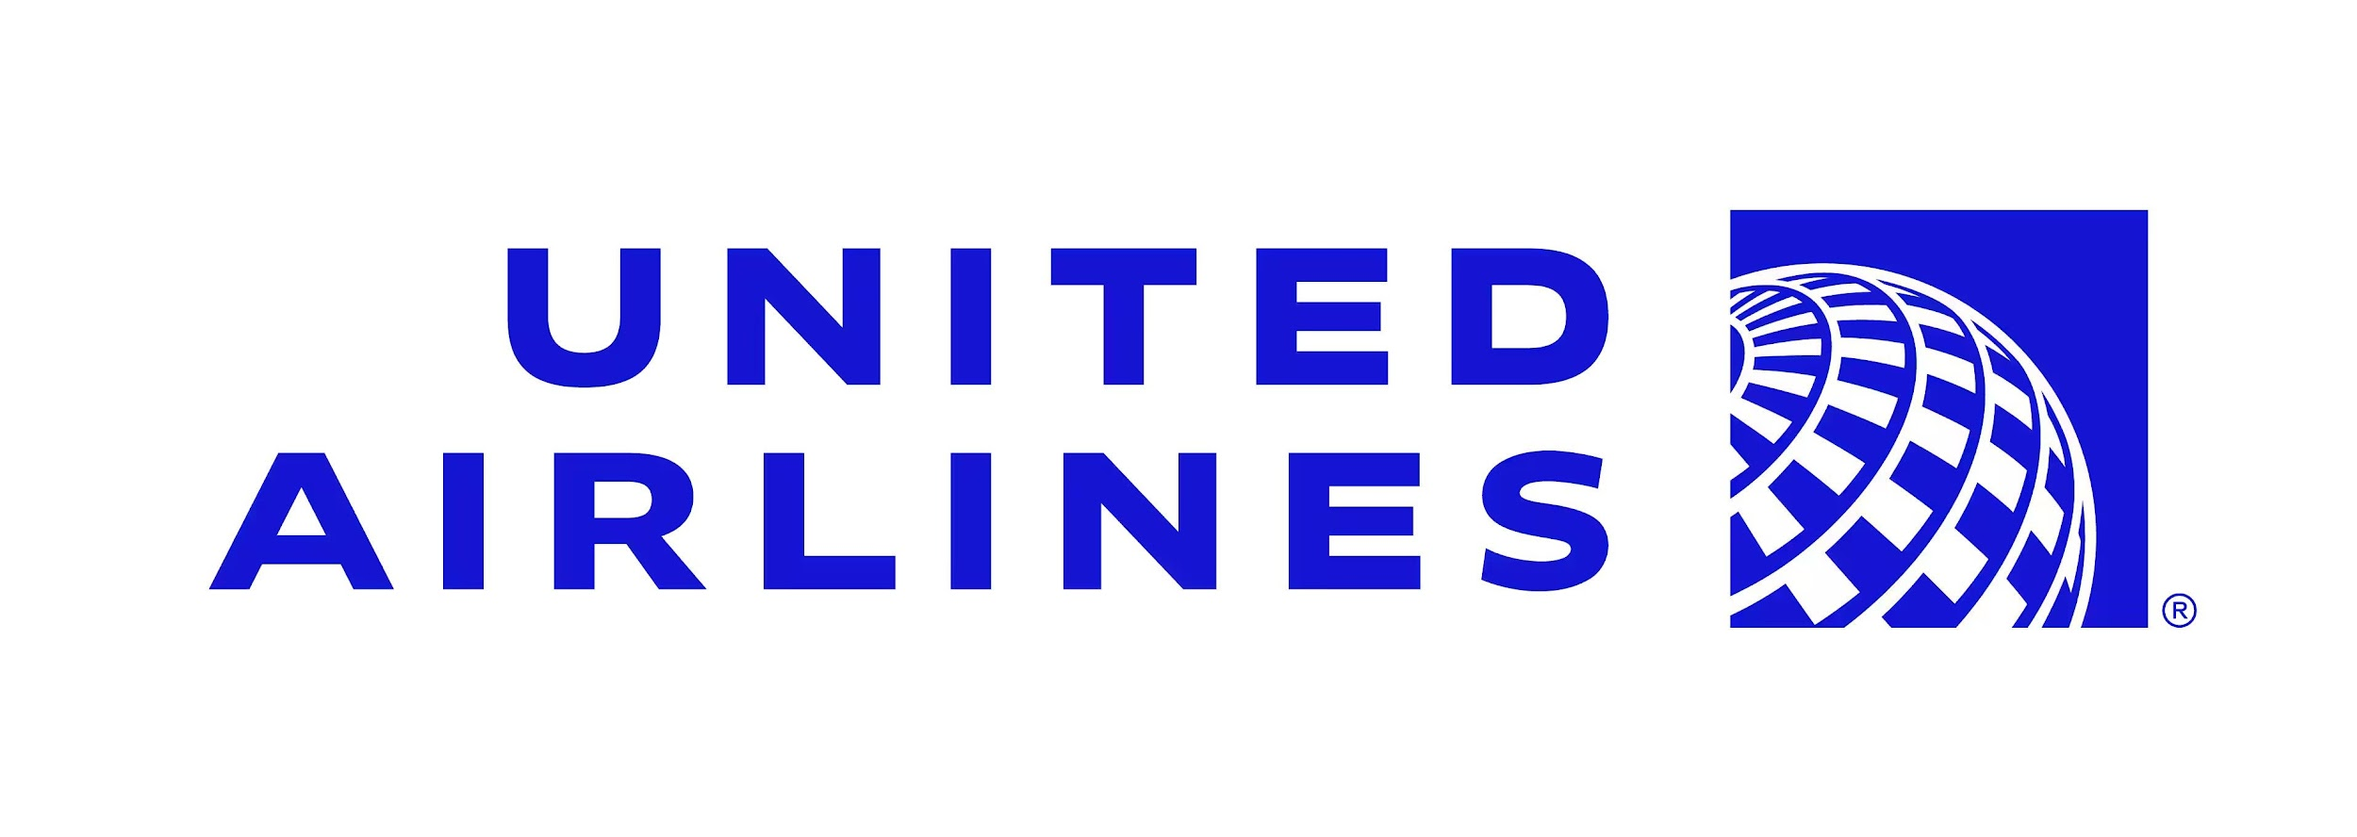
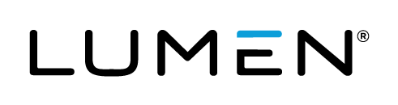
Driving Amazing Outcomes
Improve team effectiveness and alignment
Improve tool and process standardization
Improve trust, security, and resiliency
200%
$2.5M
500%
increase in throughput with better tools and more focus
saved annually by consolidating on Atlassian
faster deployments with 99.95% uptime
Notes:
The net benefit of working with Atlassian to transform how teams work together and setting up the right technology foundation for this, is actually best represented by the actual results of customers.
For Lumen, and like many others, they were in a world of tooling chaos. With the adoption of Atlassian Cloud Enterprise, which included Jira and Confluence, Lumen was able to remove the chaos and return to focusing on increasing throughput–which they achieved by by over 200%. More focus and time to get work done nets BOTH happier employees and more satisfied customers.
https://www.atlassian.com/customers/lumen
For Rivian, they centralizing and Atlassian Cloud Enterprise, they’re saving $2.5M annually on tool costs and overhead. Likewise, people and teams are much more productive having saved over 750+ hours per person just from Automation.
https://www.atlassian.com/customers/rivian
For United Airlines, they’re on a 10 year digital transformation journey. The first phase resulted in them migrating Jira and Confluence Data Center to Cloud. The process of getting to that decision was arduous. They came up with a 58-point inventory of everything they wanted out of their toolset and even considered things like change management, onboarding, and operational costs. The shortlist of options included Monday, Microsoft, and Atlassian. Interestingly, one of the reasons Atlassian won over other vendors was “intuitiveness for users outside of technology?” In fact, 40% of new Jira and Confluence users are from business teams. With that move, they’ve already increased deployments by 5x, or 500%, and are delivering 99.95% uptime.
https://www.atlassian.com/customers/united-airlines

Slide 30
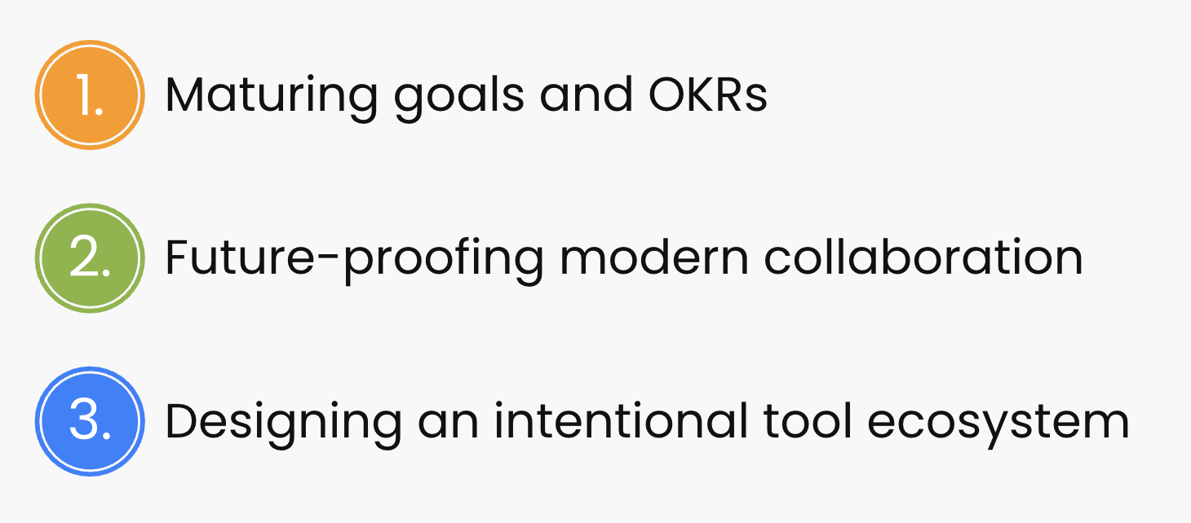








SERVICES | IMPLEMENTATION, ONBOARDING, CHANGE MANAGEMENT
ATLASSIAN ADVISORY SERVICES
CHANNEL PARTNER TRAINING & PRACTICES
1. Subscription Plans
3-tier, consultative, outcome-based, covers all solution spaces and products
Implementation services
Training and onboarding
Transformation around key themes:
2. Services Catalog
Shorter-term, domain-focused offerings to address critical team practices
Agile-at-scale
DevOps
Cross-team agility
Service
management
Enterprise
Platform
Work
management

Slide 32
Project management
Knowledge management
Time management
Workflow automation
Data analytics
Generative AI
Sales enablement
Employee onboarding
Mergers and acquisitions
Software development
IT management
Compliance
Security
Use cases

Slide 33
TRANSFORMATION THEMES | ENTERPRISE CUSTOMER CHALLENGES
Customers are prioritizing transformations around:
1.
Maturing goals and OKRs
2.
Future-proofing modern collaboration
3.
Designing an intentional tool ecosystem

Slide 34
KEY TRANSFORMATION THEMES | CHANNEL PARTNER TRAINING AND PRACTICES
Aligning teams & work to goals
Ensuring work is visible everywhere
Connecting teamwork to org impact
1.
Maturing goals and OKRs
Improving distributed work effectiveness
Adopting asynchronous work practices
Recapturing time for core work (less meetings)
Future-proofing modern collaboration
2.
Consolidating redundant tooling
Creating a unified tooling strategy and common work language
Adopting enterprise-ready system of work
Designing an intentional tool ecosystem
3.

Slide 35
RECURRING THEMES | ENTERPRISE CHALLENGES WE OBSERVE
20%+
50%+
15%+
4x
wasted time
broken collaboration
frustrated teams
unsustainable spending
20% or more of an employee’s time is lost per day in tool chaos
50%+ of key info isn’t seen, leading to solving the same problem repeatedly
Frustrating employee experiences cause higher than normal turnover
Boutique tools can be 400% more expensive and often overkill
Above are actual quantifications of the workforce challenges a global manufacturing enterprise is currently experiencing. These numbers are consistent with other enterprise organizations observed.

Slide 36

Teamwork Foundation Journey
3. Transform how all teams work
Align all teams to goals
Plan and track work cross-functionally
Unleash the power of knowledge
1. Consolidate redundant tools
Lower costs and overhead
Improve security and resiliency
Simplify purchasing experience
2. Expand to business teams
Showcase simplified product experiences
Solve key use cases for marketing, HR, etc.
Demonstrate tech team+biz team value
Notes:
The benefits really speak for themselves. But the biggest question you might be thinking of is how to get started.
Most customers start with a desire to simplify tooling, the vendor experience around purchasing, and standardizing ways of working and other processes. This means getting rid of redundant tools and processes, thereby lowering costs and overhead. As we learned, organizations that standardize on Atlassian not only improve the effectiveness and cross-functional alignment of all teams, better positioning their workforce to execute against company revenue goals, they also improve the security and resiliency of the business overall.
The next step is to expand to business teams across the board. This is most successful with a “show don’t tell” approach led in partnership with IT and a workplace solutions team (or equivalent), in which current status quo processes are compared against streamlined alternatives. Rivian did this when they compared collaboration on projects via email, which was the current process, versus collaboration on projects with Jira.
Finally, when tech and business teams are bought in, the promise of teamwork transformation is realized across the entirety of the organization. This entire process can actually happen very quickly too. The important thing to note is that Atlassian is here and will support you 100% along the journey.

Slide 37
The value of going wall-to-wall with Atlassian
88
%
employees save up to 5 hrs of meetings per week
L3. Transform how all teams work
Align all teams to goals
Plan and track work cross-functionally
Unleash the power of knowledge
87
see work centralized with better visibility
%
86
%
of customers see removal of siloes
77
save up to 5 hrs per week seeking information
%
Source: Platform Techvalidate Survey

Slide 38
TEAMWORK FOUNDATIONS | A BETTER BASIS FOR EFFECTIVE COLLABORATION
Replace most meetings
Focus on the work that matters
Help teams work better together
Leverage AI to focus on core work
88%
87%
86%
77%
of employees save 5+ hrs of meetings per week
see work centralized with better visibility
of customers see removal of siloes
save up to 5 hrs per week seeking information
Source: Platform Techvalidate Survey

Slide 39

TEAMWORK FOUNDATIONS | A BETTER BASIS FOR EFFECTIVE COLLABORATION
Faster time to value
Less rework
More time to focus
Less frustration
40%
32%
35%
50%
less time spent onboarding employees
improvement in project success rate
fewer interruptions due to better workflow
less time spent trying to find information
Report: Analyzing the Economic Benefits of Improving Work Management with Atlassian

Slide 40
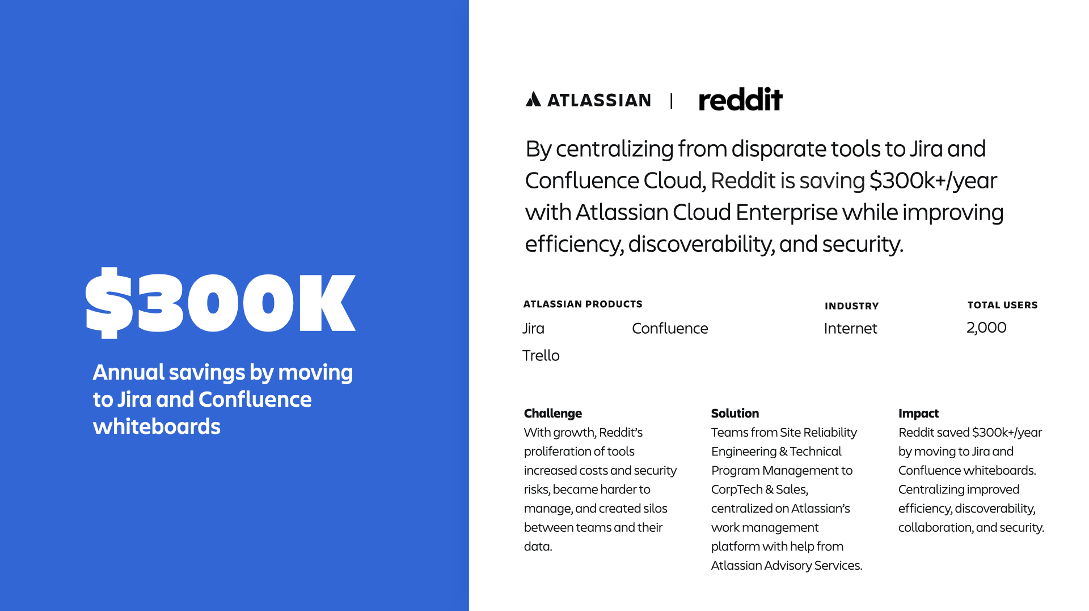
Notes:
https://www.atlassian.com/customers/reddit
See how centralizing on Atlassian cloud tools saved Reddit $300k+/year while improving efficiency, discoverability, & security.
About: Reddit is an online platform on a mission to bring community, belonging, and empowerment to everyone in the world. Reddit is home to thousands of communities, endless conversation, and authentic human connection.
Challenge: As Reddit grew, the company’s proliferation of tools increased costs and security risks, became harder to manage, and created silos between teams and their data.
Solution: Reddit centralized with Atlassian to ensure a connected experience for users which has increased usage, streamlined processes, and improved visibility across the organization. Over 2,000 employees across the company, from Site Reliability Engineering & Technical Program Management to CorpTech & Sales, centralized on Atlassian’s work management platform.
Products: Jira, Confluence, Guard
Impact: Reddit saved $300k+/year by moving from disparate tools to Jira and Confluence whiteboards. Centralizing also improved efficiency, discoverability, collaboration, and security.

Slide 41

We're saving over $300,000 per year by moving from other tools to Jira and Confluence.
MATT CHESTER SENIOR SYSTEMS ENGINEER, REDDIT

Slide 42
Confluence will be our single source of truth for documentation moving forward.
MATT CHESTER SENIOR SYSTEMS ENGINEER, REDDIT

Slide 43
Our whole dev pipeline and planning process runs through the tools. It's driving a lot of the business, and it's just easier when everyone is in Atlassian.
MATT CHESTER SENIOR SYSTEMS ENGINEER, REDDIT

Slide 44
Teams love how all the tools are connected. They can brainstorm using Confluence whiteboards, then open tickets from the whiteboard without leaving Confluence... Now, many teams are using it.
MATT CHESTER SENIOR SYSTEMS ENGINEER, REDDIT

Slide 45
Usage has really grown over the years. Our dev teams live and breathe in Jira.
MATT CHESTER SENIOR SYSTEMS ENGINEER, REDDIT

Slide 46
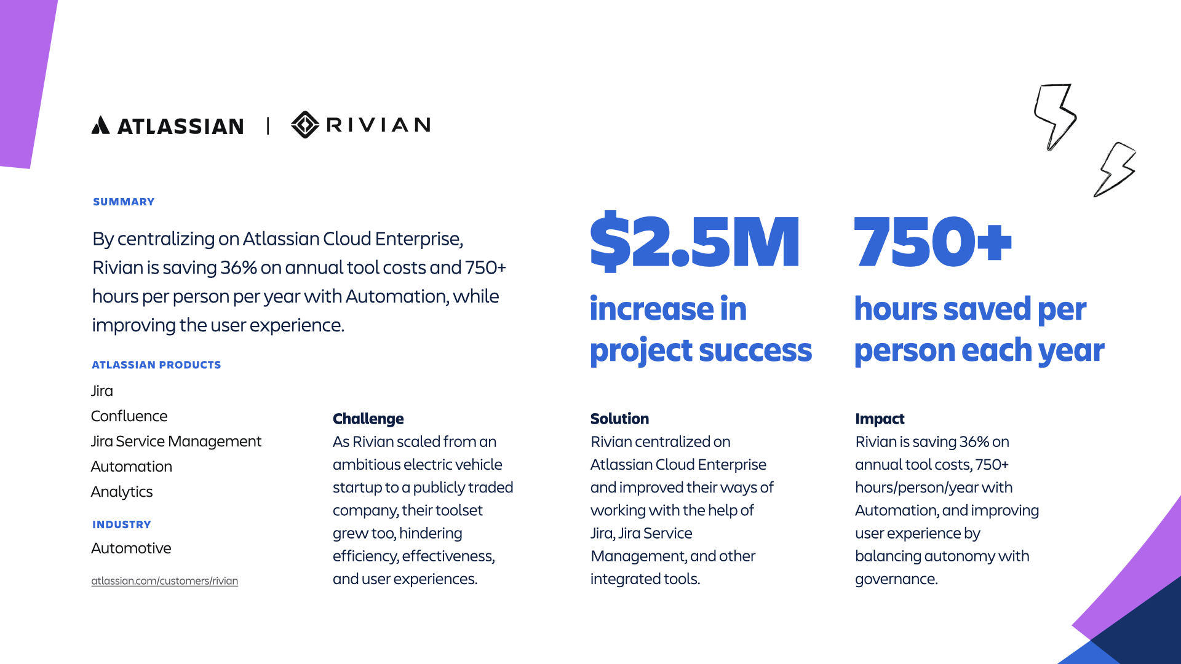
Notes:
By centralizing on Atlassian Cloud Enterprise, Rivian is saving 36% on annual tool costs and 750+ hours per person per year with Automation, while improving the user experience.
atlassian.com/customers/rivian
About: Rivian is an electrical vehicle company whose focus is on forever. As the first automaker to bring a fully electric pickup to the consumer market, Rivian is on a mission to stop the carbonization of our atmosphere.
Challenge: As Rivian grew quickly from an ambitious startup to a world-renowned, publicly traded company, their collection of tools grew too, hindering efficiency, effectiveness, and the user experience. At one point they had 5 different project management tools across the company. To reach their goals, they had to improve their tools and their ways of working.
Solution: Improve the selection of systems and tools available to employees while aligning teams with the platforms needed to do their best work. Ensure employees have simple, secure, and integrated ways to connect, communicate, and collaborate by streamlining work to Atlassian products and reducing tool sprawl.
Products: Jira, Confluence, Jira Service Management, Guard, Opsgenie
Impact: Rivian unified teams on the Atlassian cloud platform to create a single, standardized System of Work that’s improving the experience for 11,000+ users at all levels. Consolidating on Atlassian cloud helped them increase efficiency, reduce risk, balance autonomy with governance, and improve the user experience. The EV pioneer is saving 36% on annual tool costs, 750+ hours/person every year with Automation, and improving the user experience by balancing autonomy with governance.
https://www.atlassian.com/customers/rivian
*** Quotes & Testimonials ***
We found we could save $2.5M annually on tooling by centralizing on Atlassian Cloud and adding governance. That’s an annual cost savings of 36%.
EMILY NOVAK
Product Manager, Digital Workspace & Solutions
With Atlassian Automation, each stakeholder in this process is saving up to 60 hours every month on administrative work. Using Automation isn’t just about time savings – it’s about freedom. We can spend our time more wisely.
MIKE HAYES
Senior Architect, Digital Workspace & Solutions
Stakeholders didn’t know what they were missing until we pulled them into Jira, connected them with other stakeholders, and showed them ways to optimize their review processes.
EMILY NOVAK
Product Manager, Digital Workspace & Solutions

Slide 47

We found we could save $2.5M annually on tooling by centralizing on Atlassian Cloud and adding governance. That's an annual cost savings of 36%.
EMILY NOVAK PRODUCT MANAGER, DIGITAL WORKSPACE & SOLUTIONS, RIVIAN

Slide 48
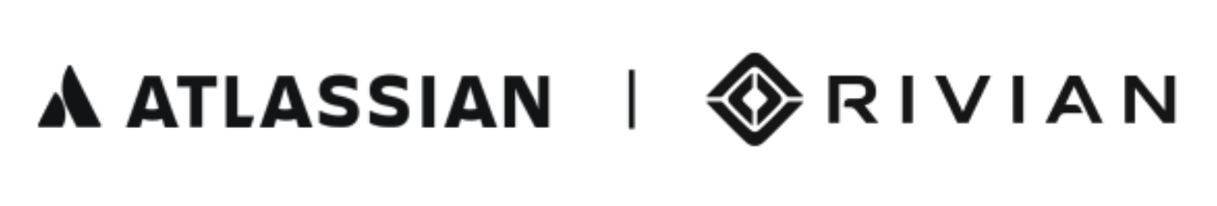
With Atlassian Automation, each stakeholder in this process is saving up to 60 hours every month on administrative work. Using Automation isn't just about time savings – it's about freedom. We can spend our time more wisely.
MIKE HAYES SENIOR ARCHITECT, DIGITAL WORKSPACE & SOLUTIONS, RIVIAN

Slide 49
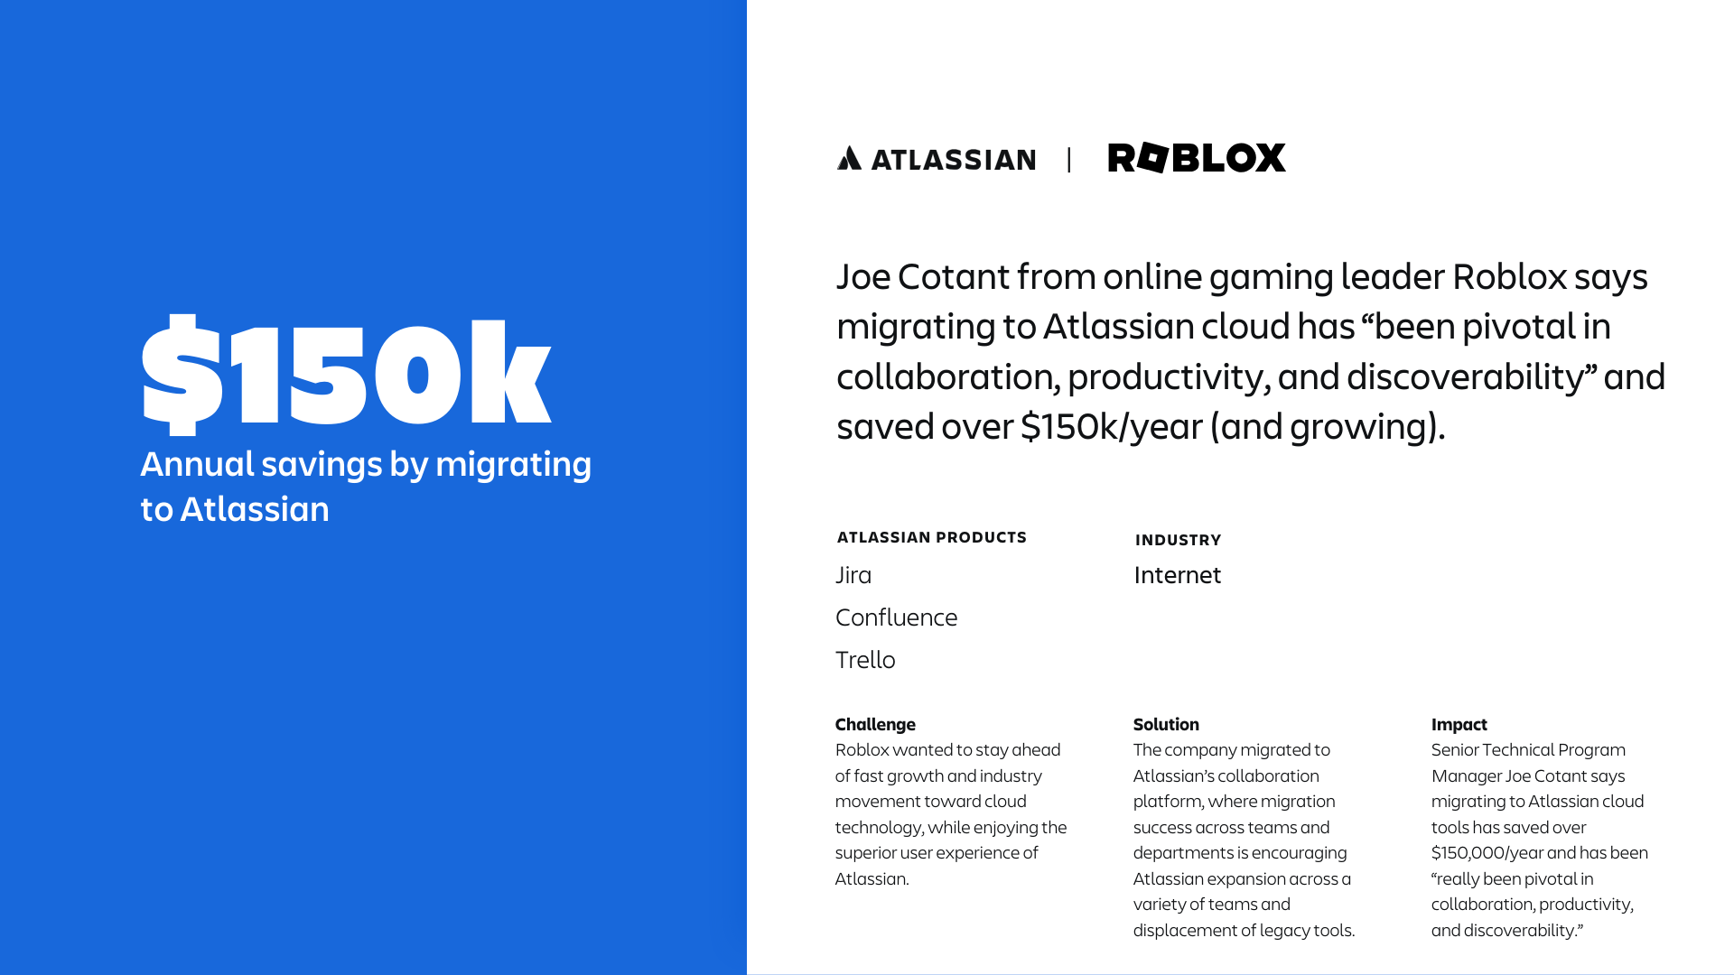
Notes:
https://www.atlassian.com/customers/roblox
Summary: Joe Cotant from online gaming leader Roblox says migrating to Atlassian cloud has “been pivotal in collaboration, productivity, and discoverability” and saved over $150k/year (and growing).
Challenge: Roblox wanted to stay ahead of fast growth and industry movement toward cloud technology, while enjoying the superior user experience of Atlassian cloud.
Solution: The company migrated to Jira Software and Confluence Cloud with the help of their Solution Partner, Modus Create.
Impact: Senior Technical Program Manager Joe Cotant says migrating to Atlassian cloud tools has saved over $150,000/year and has been “really been pivotal in collaboration, productivity, and discoverability.”

Slide 50
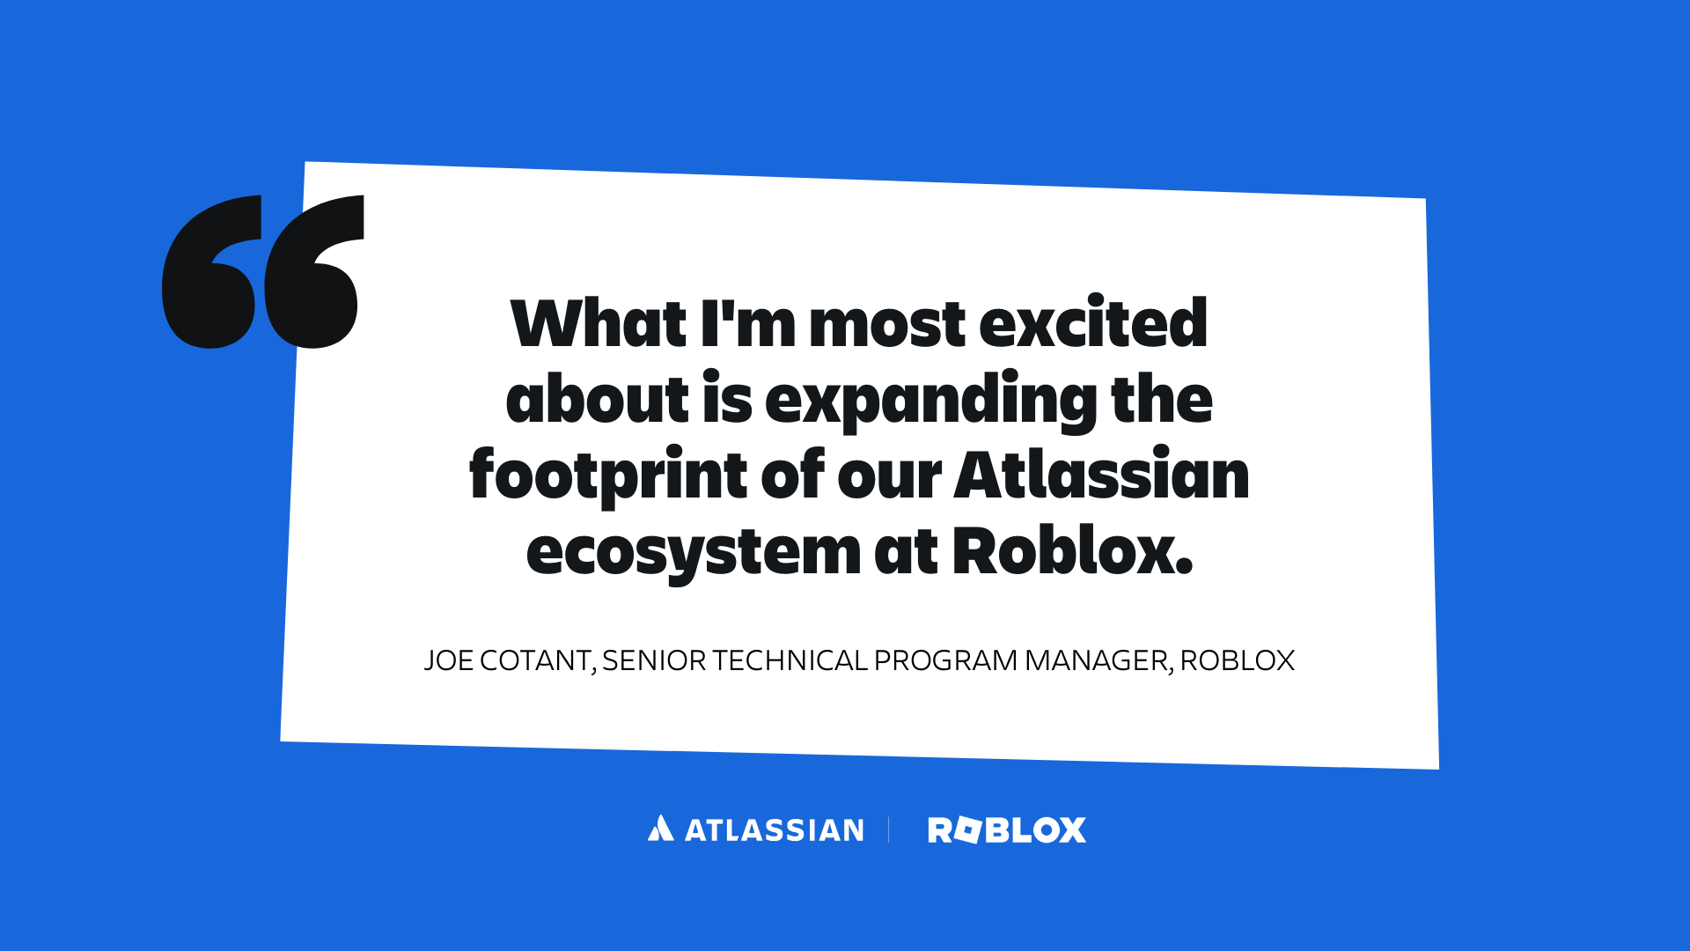

Slide 51
