Slide 1

Remove developer friction, improve software + team health, and reduce risk with Atlassian's developer experience platform

Slide 2
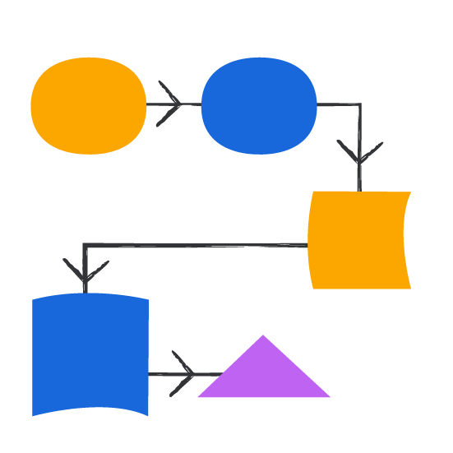
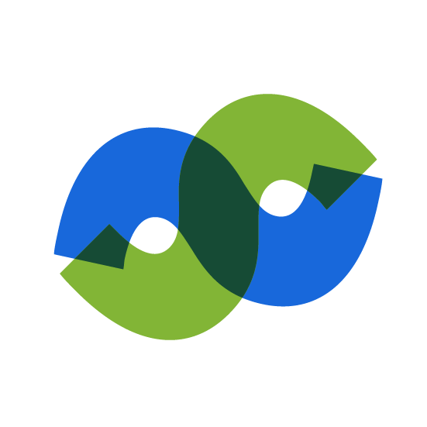

Engineers face increased friction getting in the way of their daily jobs
Complexity
Explosion of cloud services, frameworks, libraries, etc.
DevOps Challenges
Increased dev responsibility for reliability, security, risk, and cost
Information overload
Hard to find info about tools, processes, dependencies, etc
Notes:
The way software is developed has changed significantly over the past 10 years with two key shifts:
First, we’ve seen a rapid move towards cloud-first software, with a corresponding shift from monoliths to distributed architectures like microservices.
Second, there’s been changes to ways of working with DevOps and a You Build It You Run It mindset.
These changes have dramatically increased the complexity associated with delivering software to production.
Developers are now expected to do and know more than ever. In addition to writing code, they’re responsible for testing and security.
They need to understand Cloud and AI. They need to respond to incidents and stay on top of new advancements in AI and Machine Learning.
That’s just intrinsic complexity associated with being a developer. Companies are under pressure to be first to market with new features, while keeping their systems safe and secure
This means governance processes, meetings, new regulatory requirements to be aware of
All of this complexity leads to information overload for developers, who are now spending as little as 20% of their time coding and shipping software to production

Slide 3
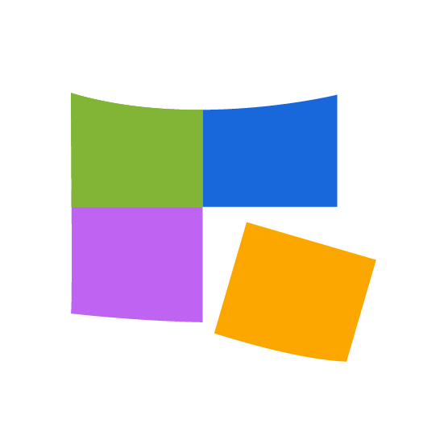
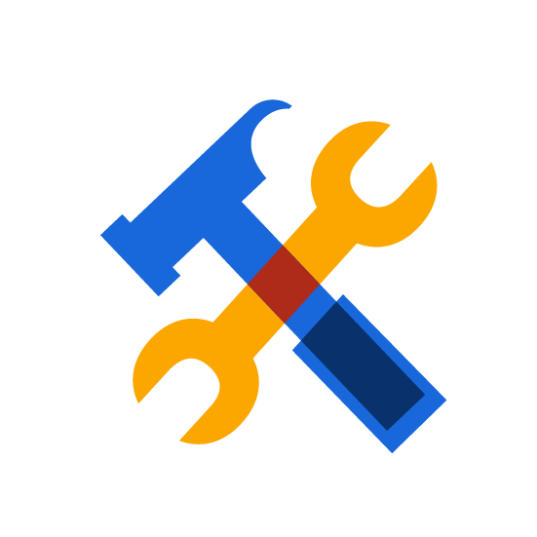

This complexity comes at a cost to innovation + velocity
Disconnected data
25% of your devs spend more than an hour per day looking for things to do their job
Disconnected tools
Organizations with over 2,000 employees use over 200 tools on average
Disconnected people
70% of developers encounter a knowledge silo at least once a week
Notes:
All of that complexity comes with cost to organizations.
The 2023 Stack Overflow survey found that 25% of developers reported spending more than an hour per day looking for information.
That’s one hour per day, not solving problems, not creating value, just looking for information.
Organizations with over 2,000 employees use over 200 tools on average. To put it into context for a developer, if they’re troubleshooting an issue they’re looking through multiple tools, navigating multiple interfaces, needing to know how to use different tools, to find what they’re looking for.
And it’s not just looking through tools, 70% of developers encounter a knowledge silo at least once per week. Which often results in rework or duplicated effort.
All of this complexity is a recipe for a poor developer experience, and the inability to deliver high quality software to production.

Slide 4
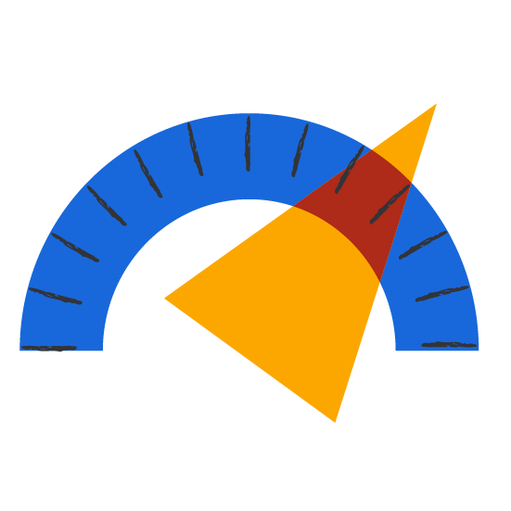
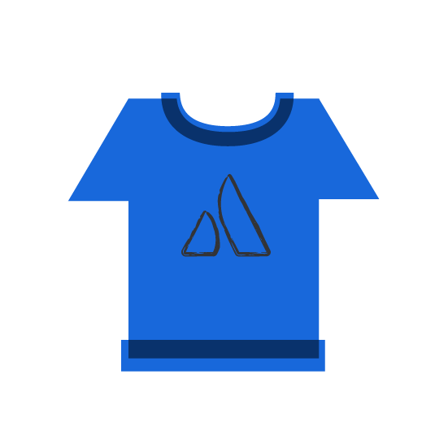

Where developer experience fits in
Developer experience focuses on the
lived experience of devs and the points of friction they encounter in their everyday work
Improved developer productivity
Healthy engineering culture
Risk management and reliability
Notes:
We experienced these issues ourselves at Atlassian, which is why we built our developer experience platform, Compass.
Compass has allowed us to improve the developer experience for our own developers, which has helped us improve productivity, further embed a healthy engineering culture, manage risk and reliability across a sprawling microservices environment

Slide 5
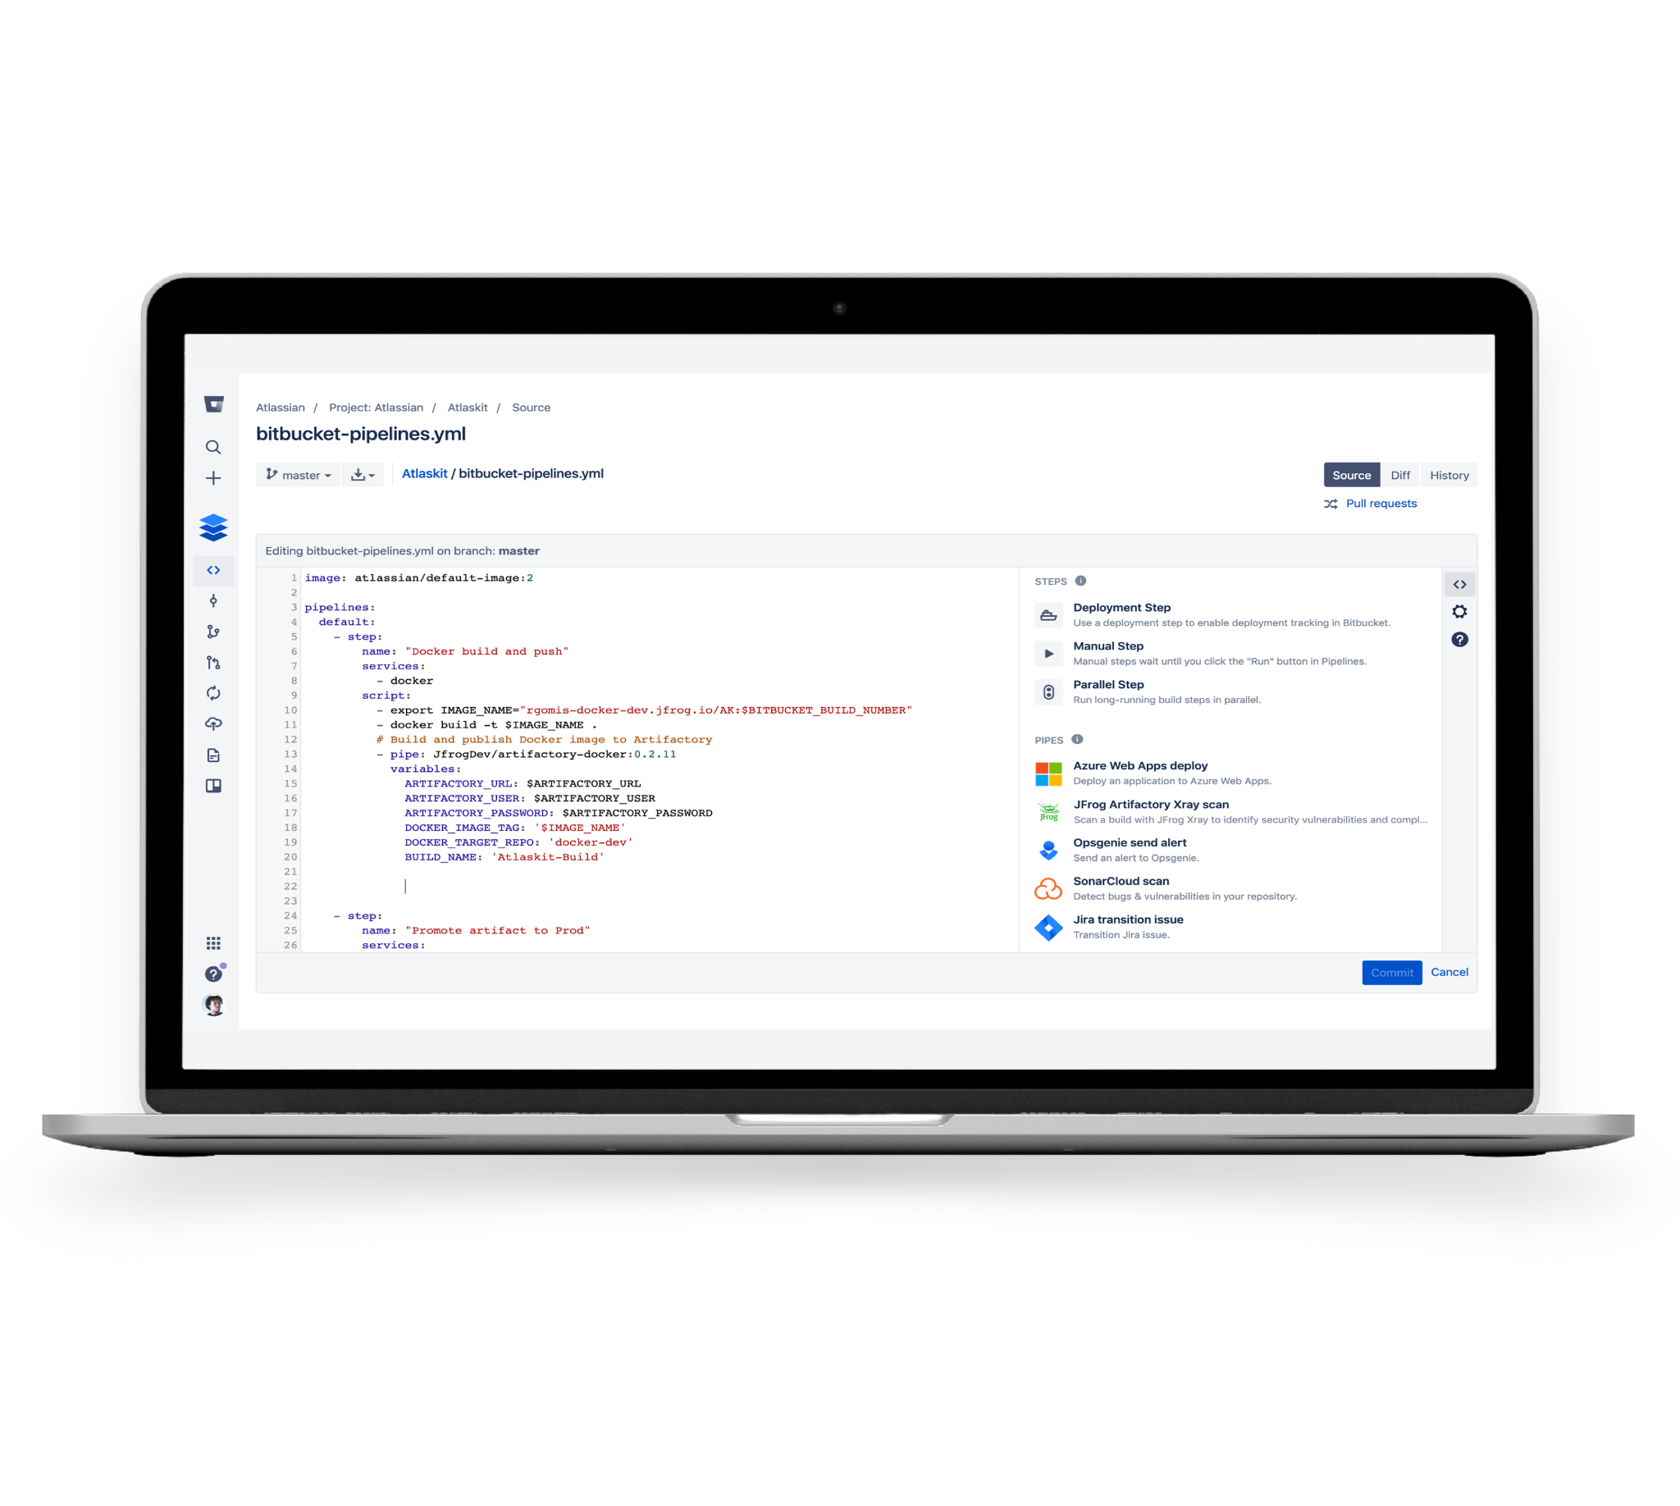
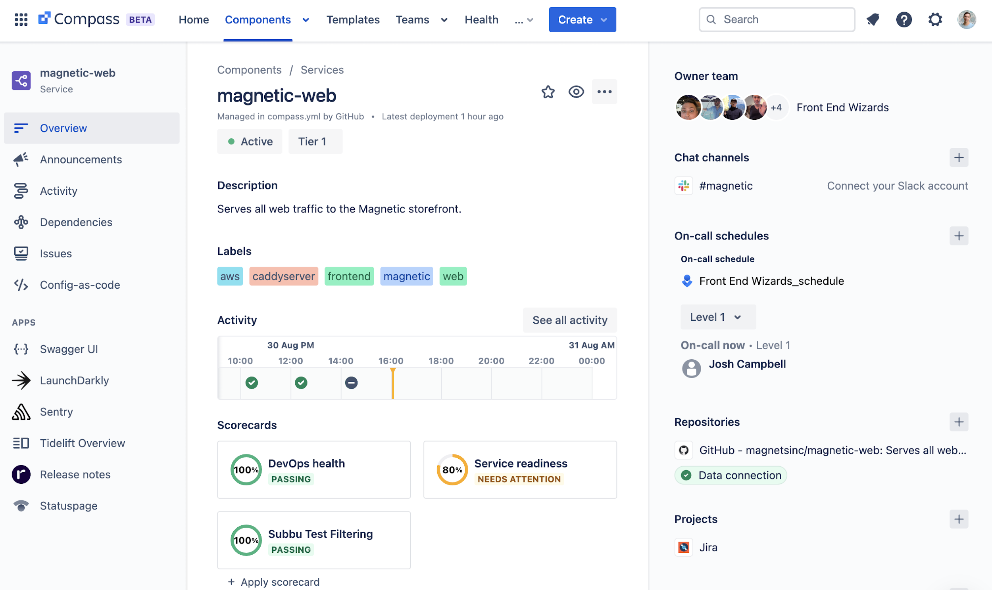
Introducing Compass
Remove developer friction, improve software + team health, and reduce risk with Atlassian's internal developer platform
Notes:
This is Compass. We’ll be break down who benefits most from Compass and dive into the key features and experiences that help teams operate with less day to day friction, find information faster, and improve the health of their software.

Slide 6




Keep your dev teams in the flow
—and everyone else in the know
Engineering Executives
CTO, CIO, COO, VP of Engineering
Platform Teams
Platform Engineer, Cloud Infra, IT/Jira admins, Enablement Teams
Engineering Managers
Delivery Teams
Key Challenges
Difficult to maintain productivity and velocity
Limited visibility and metrics
Promote culture that attracts and retains talent
Responsibilities
Drive overall engineering and IT vision, culture, and innovation to support business goals
Build and promote a culture that attracts and retains top engineering talent
Improve company profitability by increasing ROI for R&D, tooling, and cloud spending
Key Challenges
Removing friction for development teams
Balancing risk management for governance with developer autonomy and velocity
Change management for both tooling and cultural practices
Responsibilities
Delivering reusable services to empower developer teams (libraries, frameworks, tooling)
Providing tracking and governance for microservices/distributed architecture
Measuring improvements in developer experience
Key Challenges
Teams are overwhelmed
Poor developer experience is impacting performance
Difficult to measure and understand health
Responsibilities
Build and manage high-performing engineering teams
Deliver value faster by empowering teams, managing resources, and prioritizing work
Work with stakeholders and communicate strategy, plans, status, and metrics
Keep team focused and happy
Key Challenges
Constant disruptions from writing code
Too many things to do, continuous role scope creep
Too much time searching for information and context-switching
Responsibilities
Write, test, review, and deploy code, and monitor software in production
Track work and keep stakeholders informed of dependencies, changes, delivery timelines, and code status
Keep up with, adopt, implement, and share good practices, latest frameworks, libraries, and tools
Developers
Delivery Teams
Notes:
Customers of all shapes and sizes face complexity challenges: whether it’s:
Software sprawl as they move from monolith to microservice
Growing fast and breaking through silos as they onboard engineers
Execs, platform teams, engineering manager, and developers all have a stake in creating a great developer experience, and Compass addresses key challenges across these personas.
Executives - they care about productivity, measuring engineering output or effectiveness, and doing more with less.
Platform teams - provide internal services to software teams. Their goals are usually around providing self-serve tools and information to enable SW teams to meet their goals efficiently.
Engineering managers - Focus on creating high performing engineering teams, and usually care deeply about developer experience. They are also concerned with their teams compliance with an organizations standards and requirements
Devs – the users of Compass
Governance teams (CAB, ARB, Cyber, etc.) - They struggle to distribute their requirements across large companies, they also struggle to get good insight into compliance with their requirements across an organization
All of these teams benefit from Compass.

Slide 7






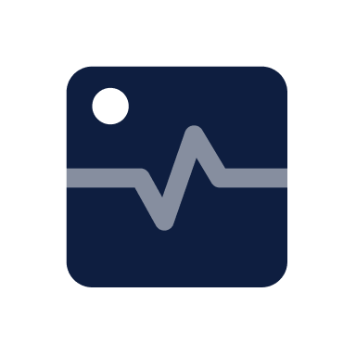
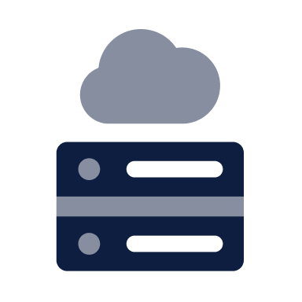


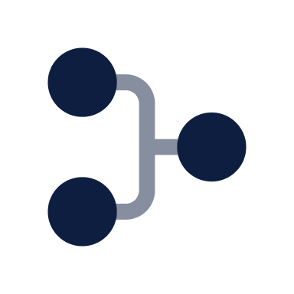

How Jira Service Management, Jira, and Compass fit together to improve your velocity and services health
The #1 software development tool used by cross-functional teams
High-velocity ITSM solutions for your entire org
Quantify tech debt with software component health connected to issues
Enhance dev experience with DORA metrics for every team, app, and component
Triage incident faster with access to component details, including owners, metrics, dependencies, etc.
Prioritize service health with all JSM incidents and activity shown in the Compass activity tracker
Reduce cognitive load through software catalog data surfaced in Jira UI with Compass
Run CheckOps to understand how recent sprints impacted key metrics and health scores
Set intuitive best practices for dev teams via scorecards to improve system health and security
Improve MTTR and dev velocity through a unified incident management + dev experience platform
Unified developer experience platform and software component catalog for all
Notes:
Compass unifies your DevOps toolchain, connecting your people with tools and data across delivery and operations, and across your organization.
[If your customer has 100+ Jira users, they’re a candidate for Compass]
Compass connects the work getting done in Jira Software with your software architecture and it’s health:
Help teams plan better sprints by understanding where technical debt is accumulating to balance maintenance with shipping new features
Reduces context switch between tools
Powers retrospectives and engineering rituals with engineering data
Empowers teams to work autonomously while meeting org standards and best practices
Compass enhances incident management & prevention alongside Jira Service management
Compass makes it easy to understand component activity and triage incidents with contextual info about ownership and dependencies, and data from across your toolchain
Gives teams a complete look at the health their components and dependencies

Slide 8







Level-up your developer experience
Improve your DevEx with a unified software catalog
Reduce cognitive load with a comprehensive software component catalog so developers can move faster
Get a complete view of your service health
Apply security and health scorecards, build and communicate policies, and empower teams to improve operations
Connect critical service details to save time searching
Integrate your observability, CI/CD, OSS, cloud infrastructure data, and more to save time searching and reduce context switching
Automate consistency and accelerate paths to production
Create golden paths to automate infra provisioning and deploy pipeline setup with observability, service details, and security automatically included
Notes:
There are four key-ways Compass improves developer experience and supports teams building high quality software, fast.
First, it reduces the need to remember things, also known as reducing cognitive load for developers, through a unified software catalog.
Second, Compass helps teams understand service health and enable a culture of learning and continuous improvement
Third, Compass reduces context switching by connecting with your other dev tools, bringing information into the context of the software component a developer is working on
Finally, make the right way the easy way using templates.
Let’s take a look at each.

Slide 9

Untangle your architecture
How Compass works to remove developer friction, improve software + team health, and reduce risk

Slide 10
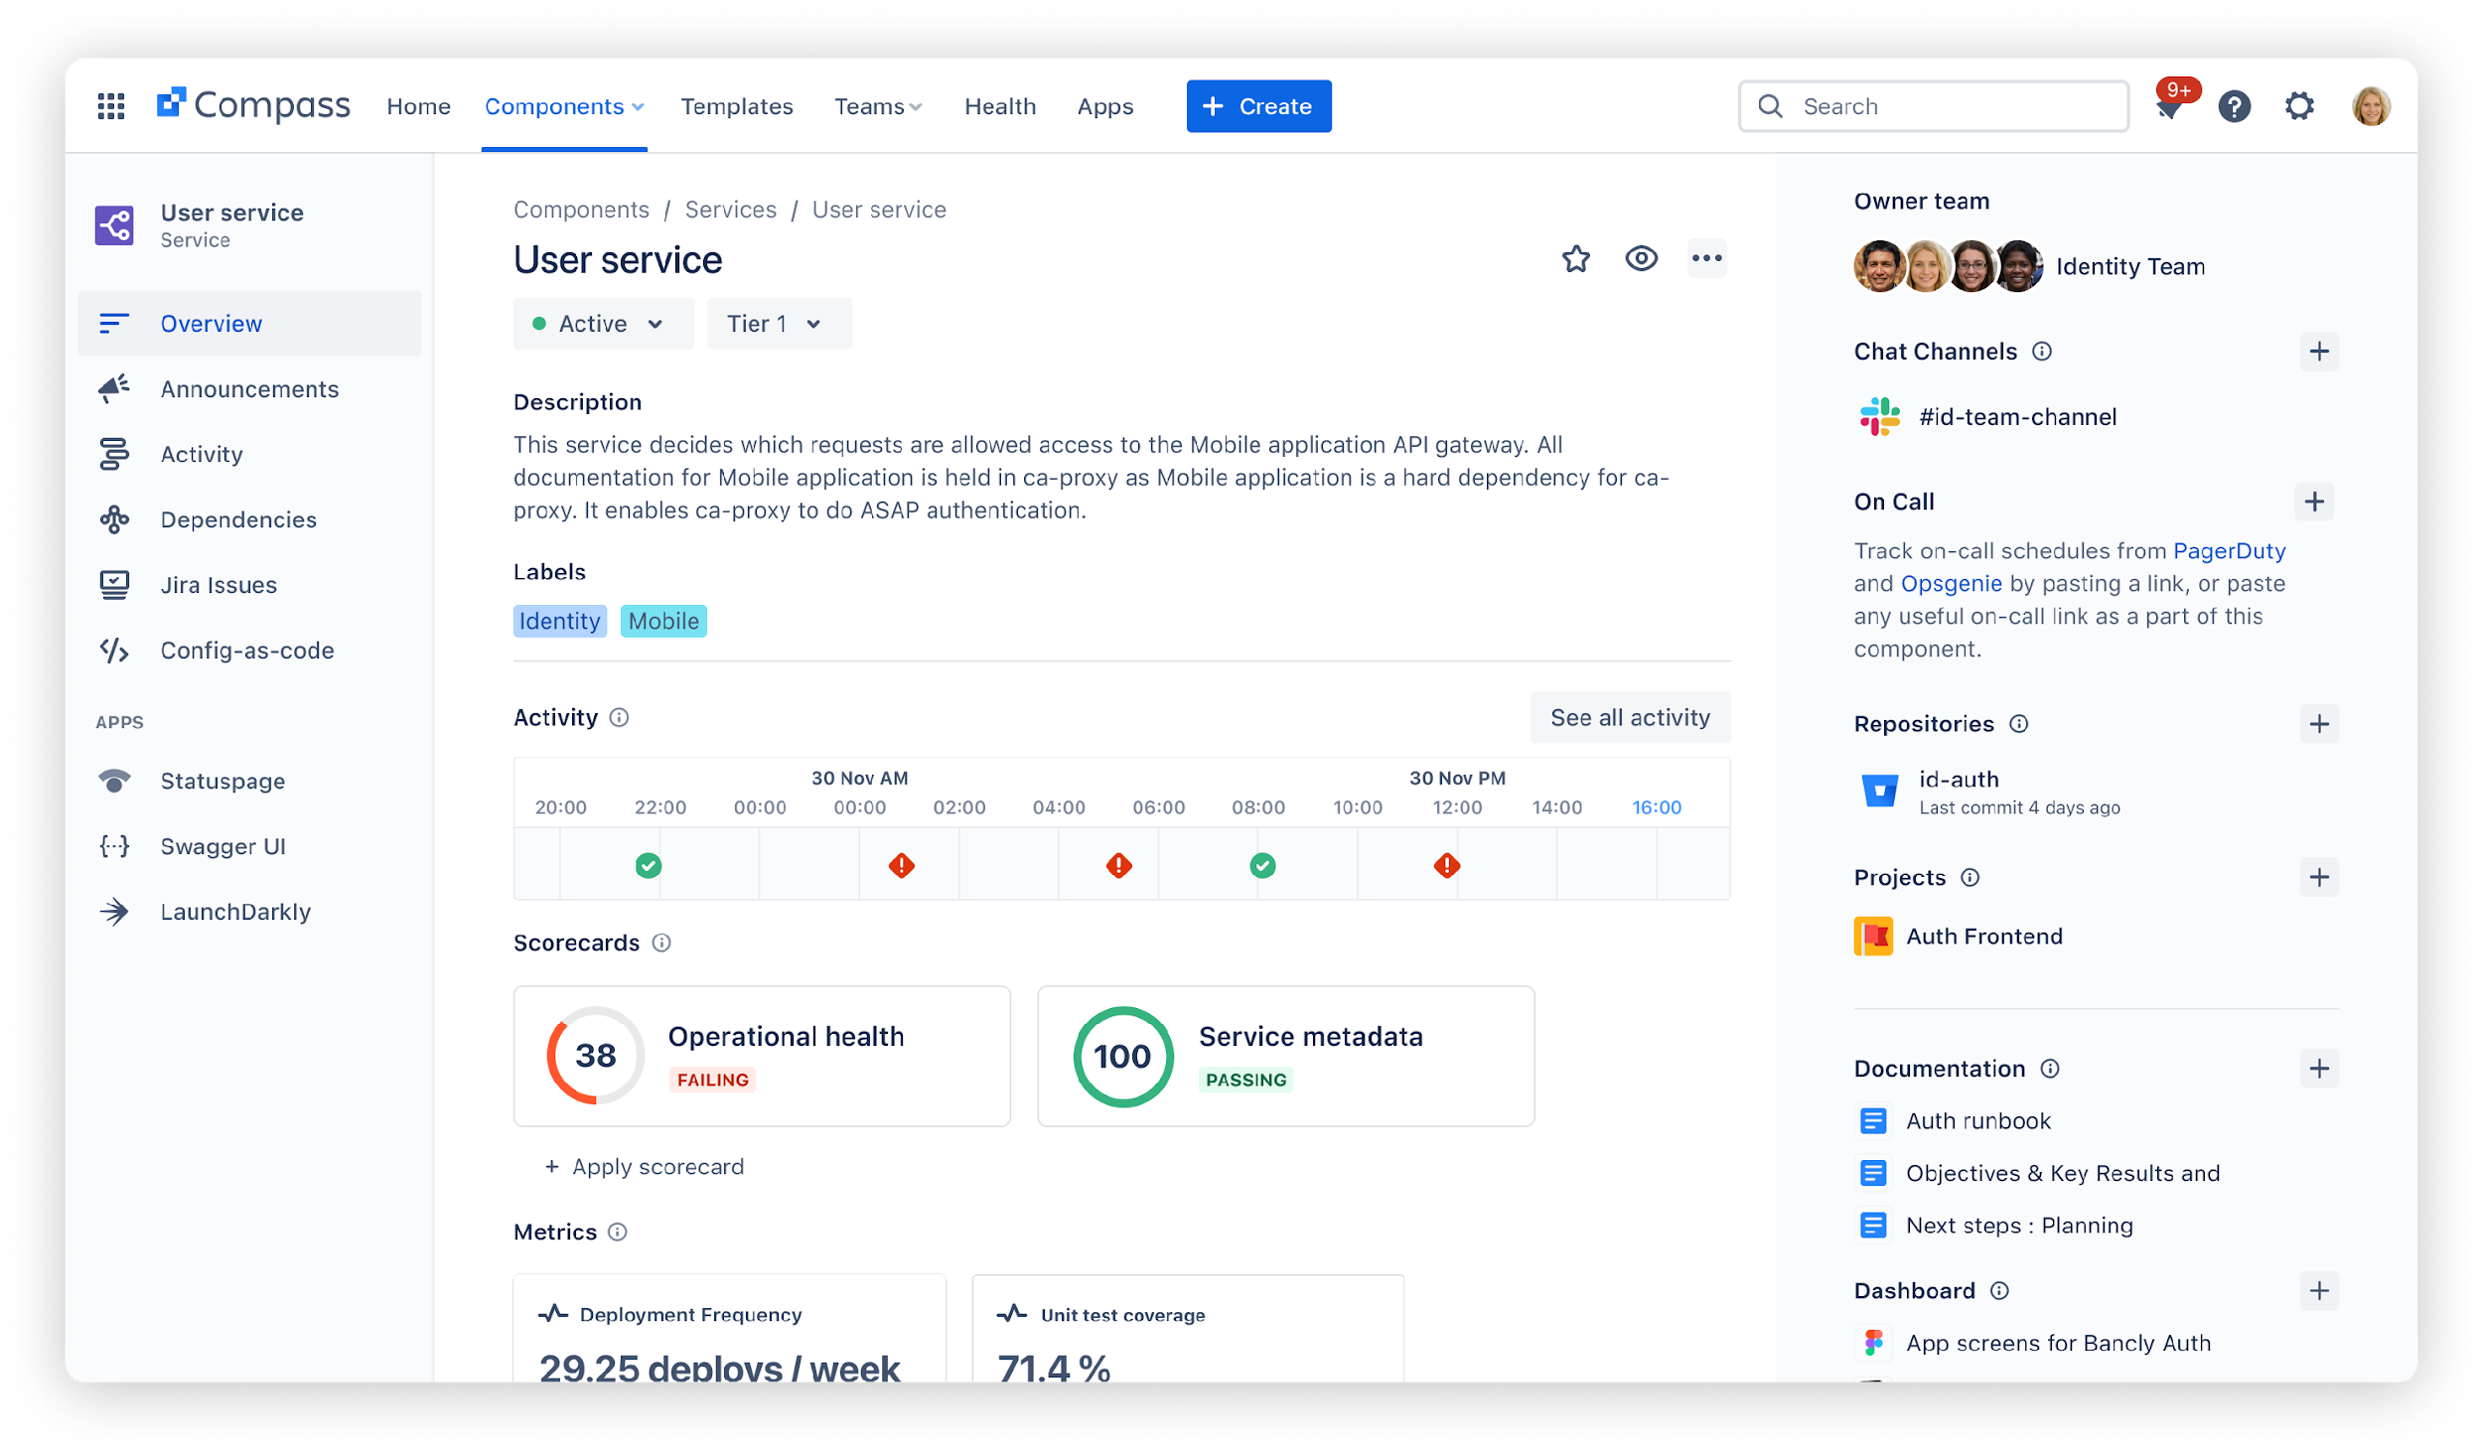

Explore all of your services, APIs, and libraries in one unified software catalog
Notes:
Cognitive load is significant - developers have to remember a lot of information just to do their day to day jobs. The component catalog reduces that cognitive load. Less time searching, less info that has be remembered.
This is the component overview page. It shows the developers critical information for understand their own software components, and other components that they might be be familiar with. That’s really useful if you’re trying to leverage and API or reuse and existing service.
The overview page give developers lots of information at a glance, including information from external tools that teams link through apps or the open APIs. That means less context switch browsing between the myriad of tools that developers rely on.

Slide 11
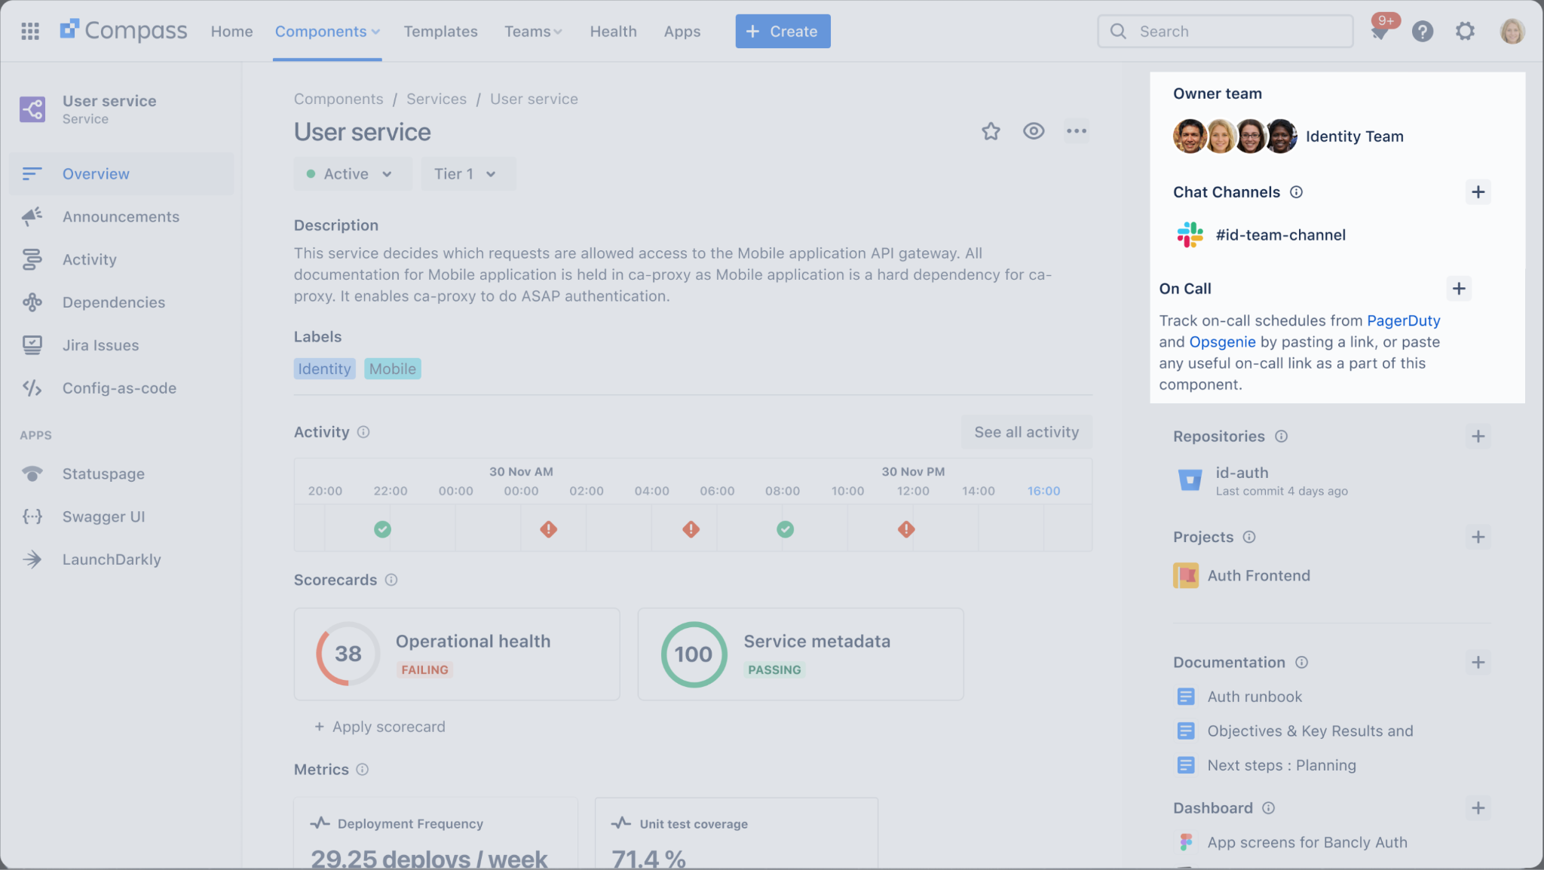
Get full visibility into service ownership and communication channels
Notes:
Along the right you can quickly identify the owning team and how to best contact.

Slide 12
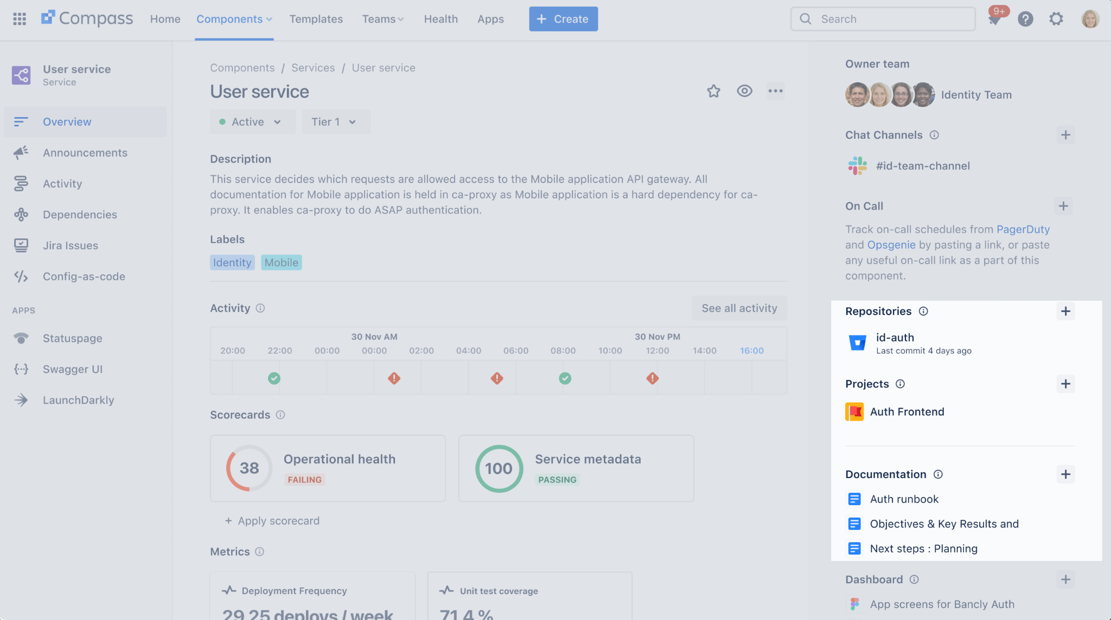
Discover relevant repos, documentation, and
related Jira projects and issues
Notes:
You’ll also see relevant repositories, Jira project where related work is tracked, and documentation. That’s great for improving self-service and reducing interruptions for basic information that can be handled asynchronously. This self-service culture means less wait-time and more high-value collaboration.

Slide 13
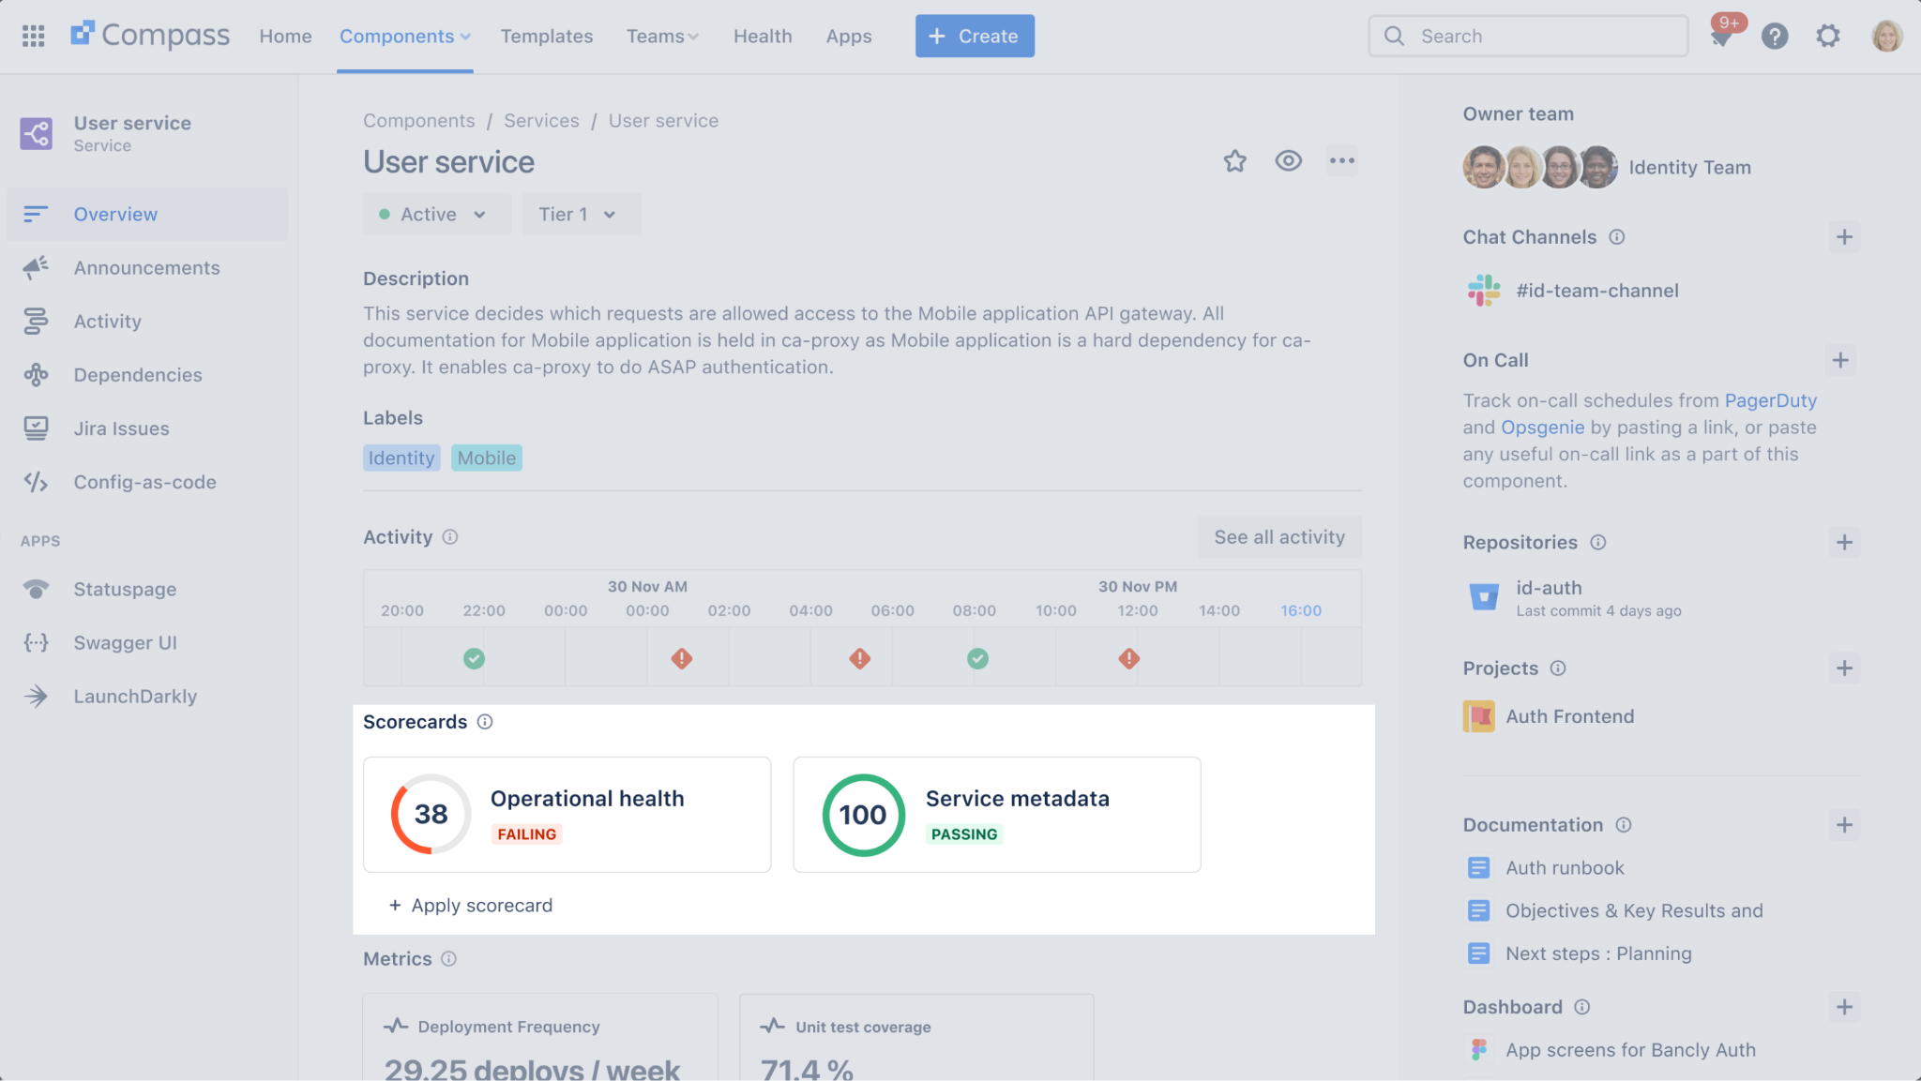
Instantly see whether a service is passing operational and risk assessment scorecards
Notes:
In the center you’ll see scorecards. Teams can instantly see how a software component measures against organizational standards and practices.

Slide 14
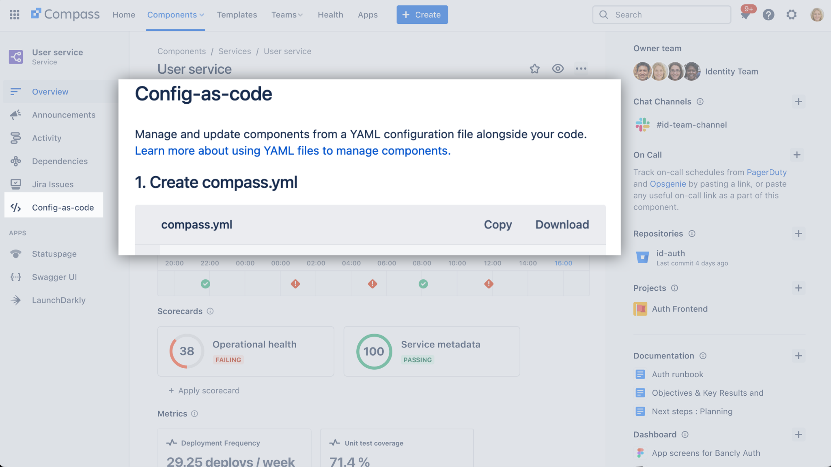
Keep all of your software components up-to-date directly from your repo with config-as-code
Notes:
You can even manage components with config-as-code using a YAML file.

Slide 15
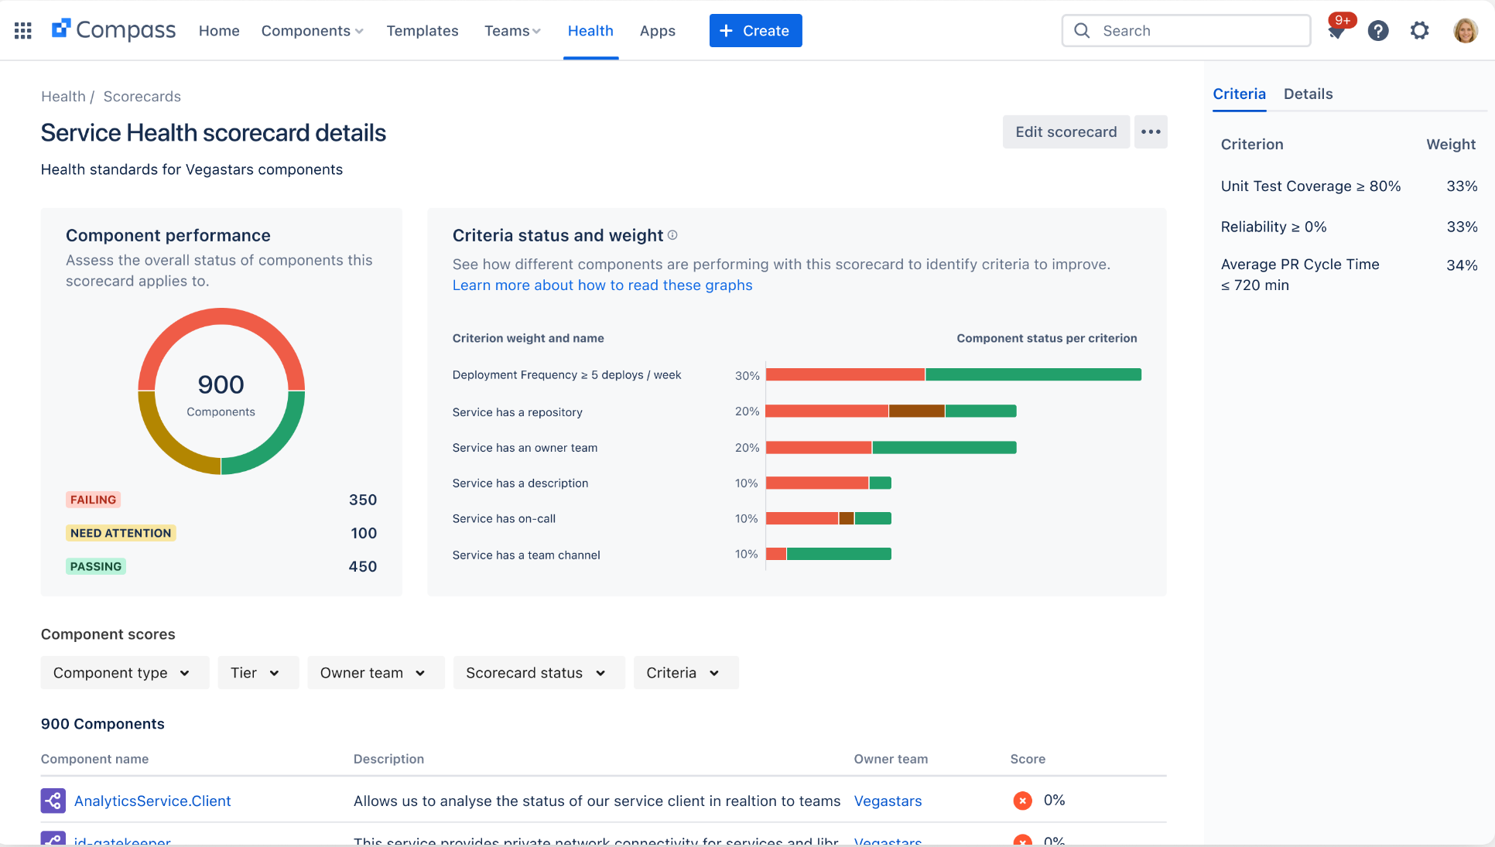
Manage the health of your services with
built-in scorecards
Notes:
Teams can see and manage scorecards in one central location. Compass comes with several default scorecards, and you can create custom scorecards using data from across your organization. That empowers teams to codify standards efficiently and embed a culture of continuous improvement and autonomy. It also means less governance meeting and greater transparency. Teams know exactly what standards to work towards and what actions are need to improve their software.

Slide 16
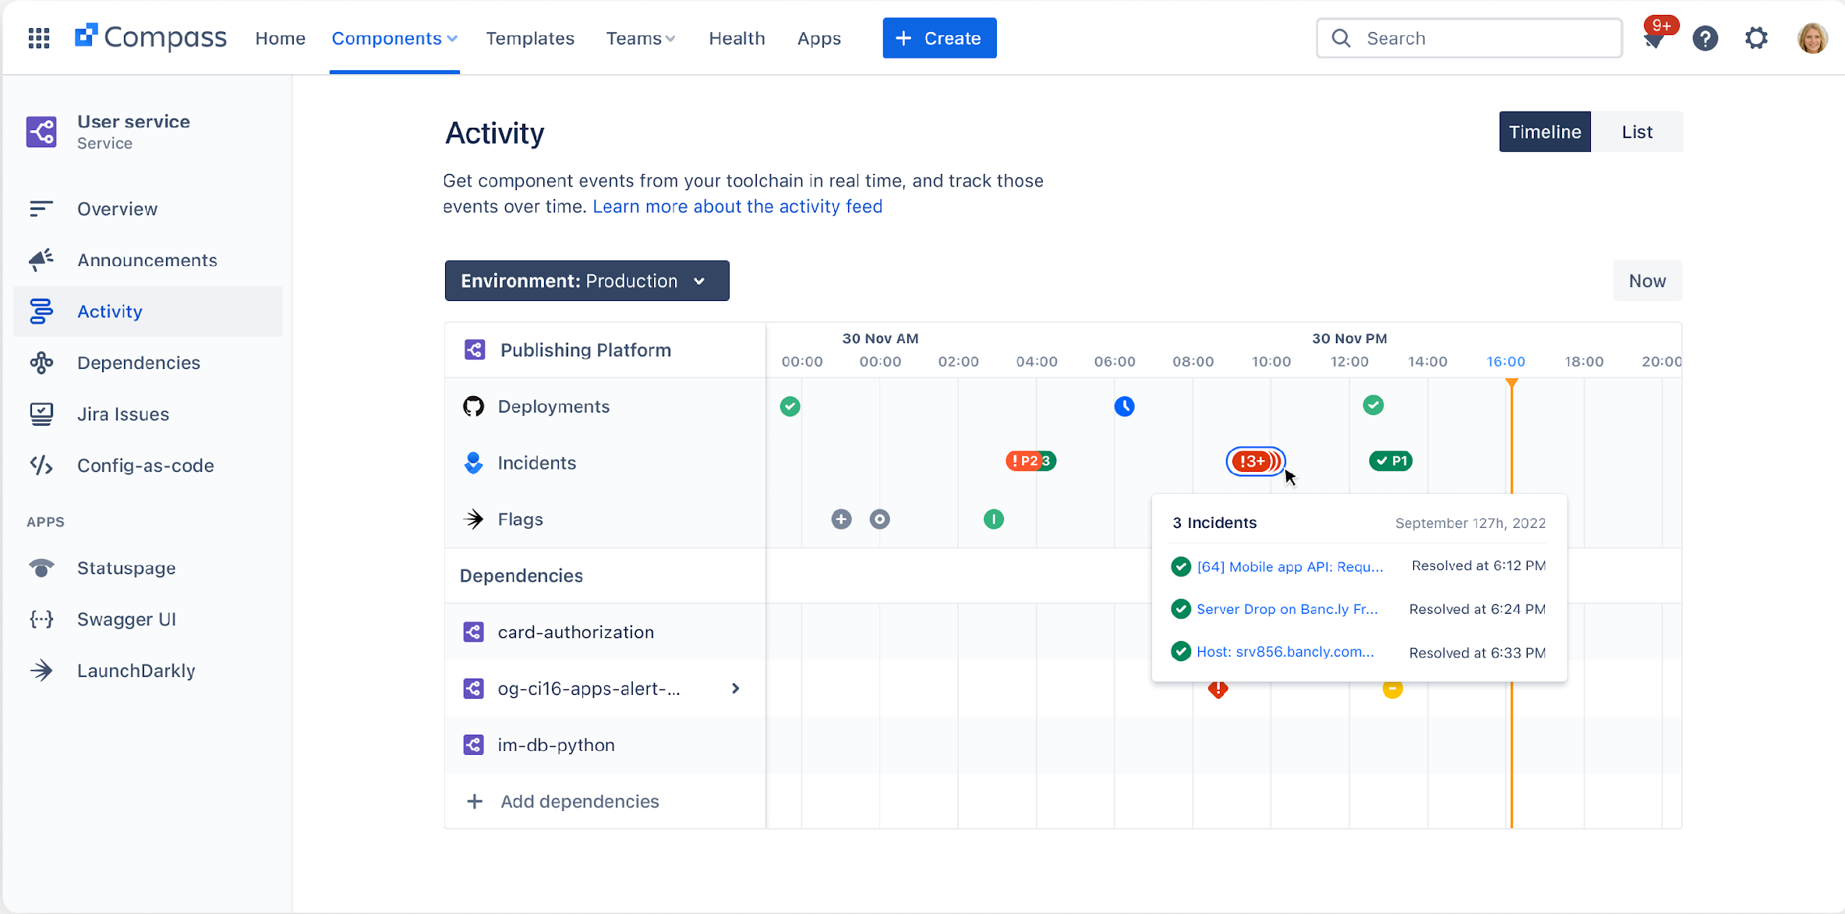
Instantly view all activity in a single place —including from upstream dependencies
Notes:
The Compass activity feed shows teams everything that’s happening related to a component - that’s activities like deployments, security events, changes on up- and downstream dependencies, feature flags, and more. Because Compass is fully extensible and built with open APIs, teams can connect their entire toolchain in one location. That means less context switch browsing between the myriad of tools that developers rely on.
That also means responding to alert in the middle of the night is easier, with relevant information for triaging a problem and quickly getting one step closer to a resolution.

Slide 17
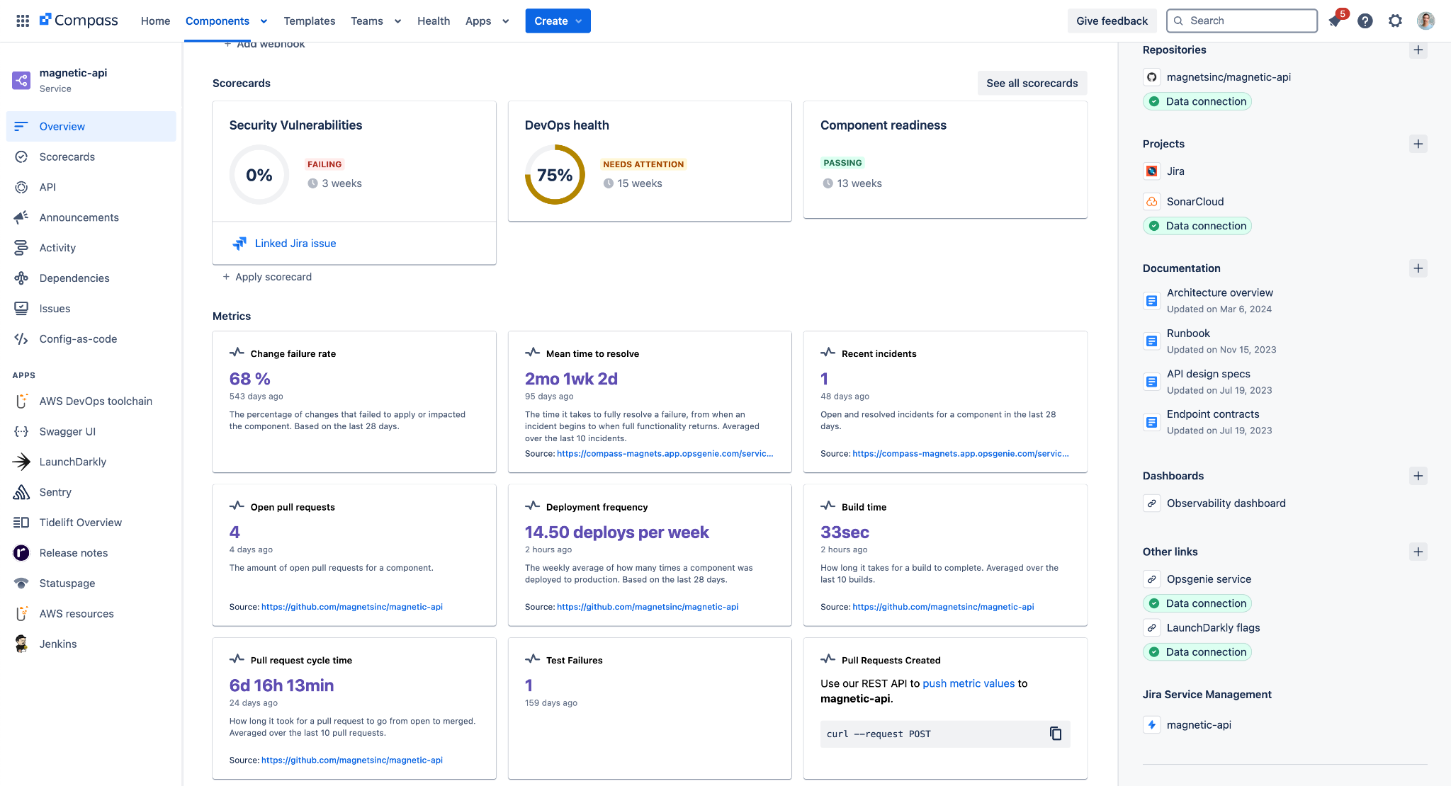
Establish and track DORA, SPACE, and DevEx metrics
across teams and services to identify bottlenecks
Notes:
Teams get DORA, SPACE, and DevEx metrics for all of their services simply by connecting a source code management tool. These metrics can be used to build scorecards, and can be tracked over time to improve software delivery.

Slide 18
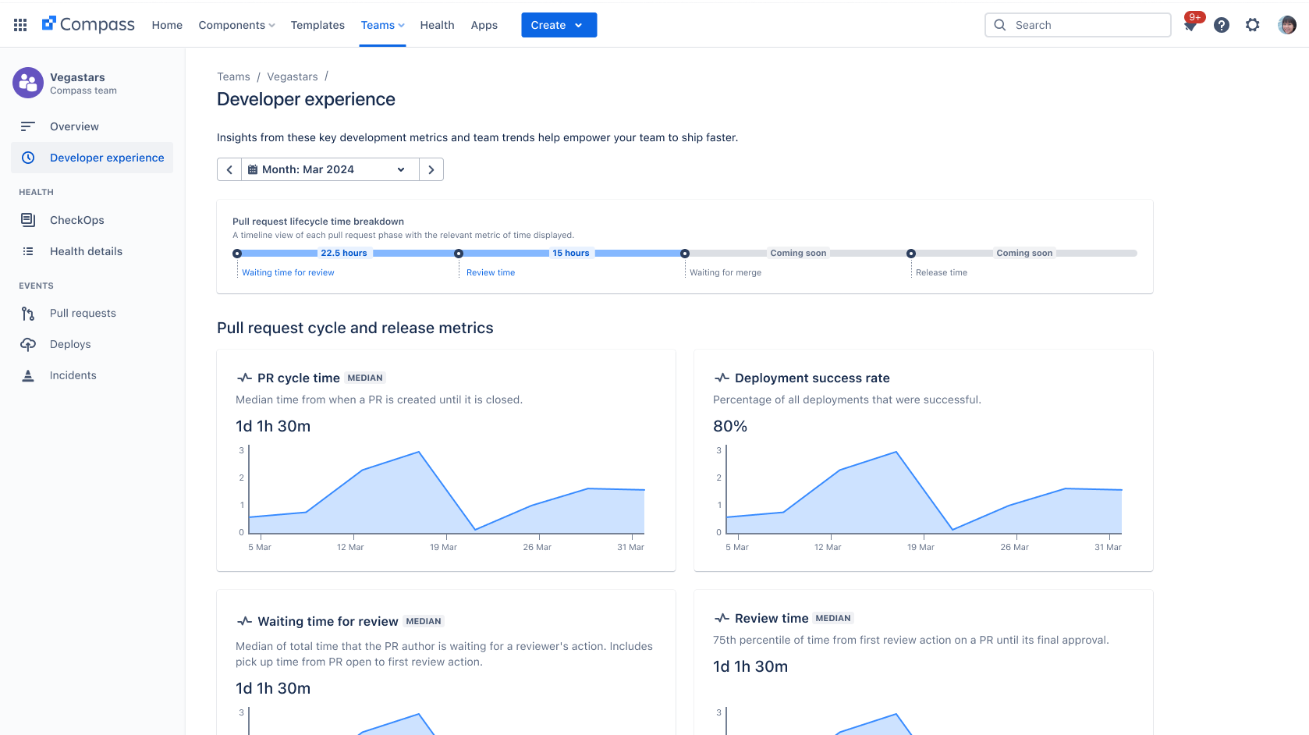
Understand and improve how work moves through your software development lifecycle
Notes:
The developer productivity dashboard show key metrics that represent how work is moving through the software development lifecycle (SDLC). It gives teams insights into how they can ship better and faster.
This dashboard helps engineering managers get a sense of how work is moving through development, identify opportunities to improve in certain areas, and see any emerging team trends (good or bad) to inform how you plan and do work as a team.
The dashboard shows the following metrics:
Pull request cycle time - Median time from when a pull request is opened until the time it’s closed
Deployment success rate - Percentage of all deployments that were successful
Waiting time for review - Median of total time from when a pull request is opened to the first review action
Review time - 75th percentile of time from first review action on a pull request until its final review action

Slide 19
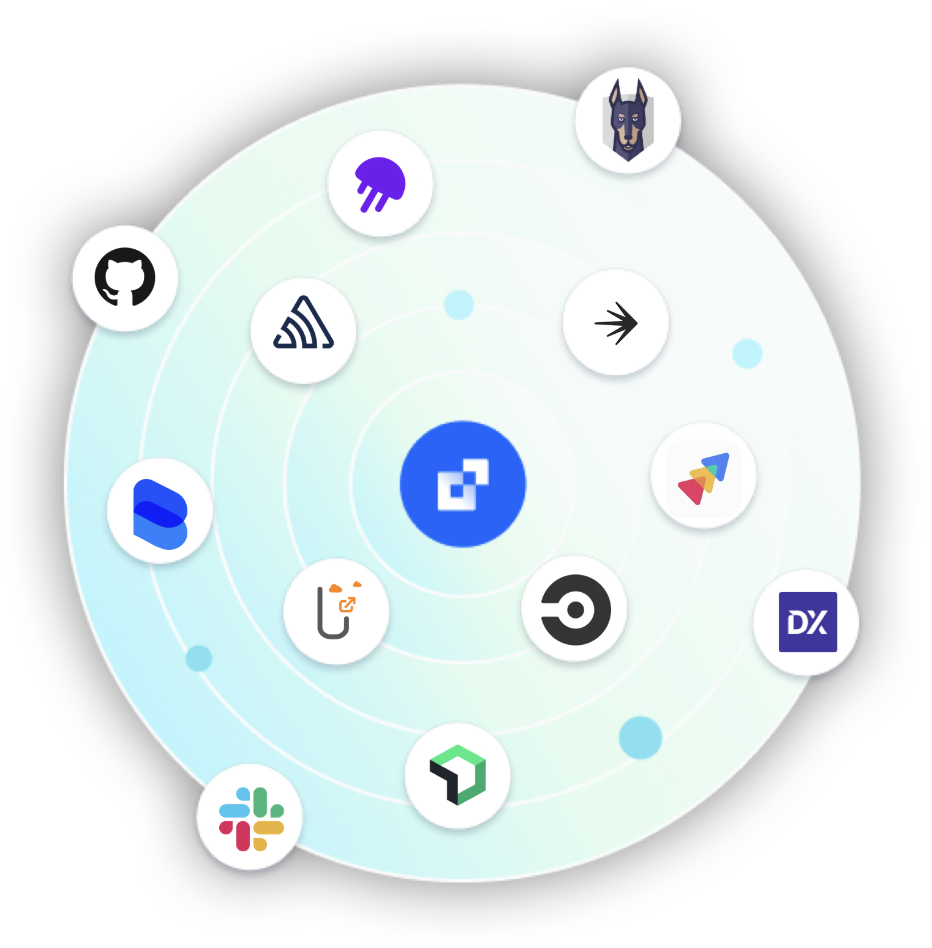
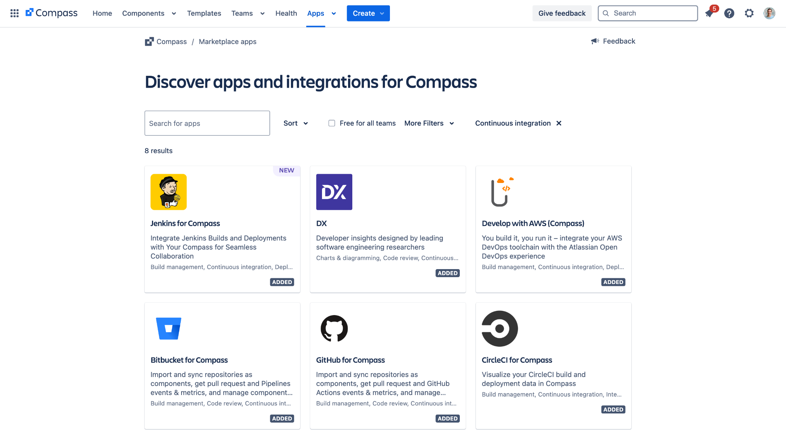
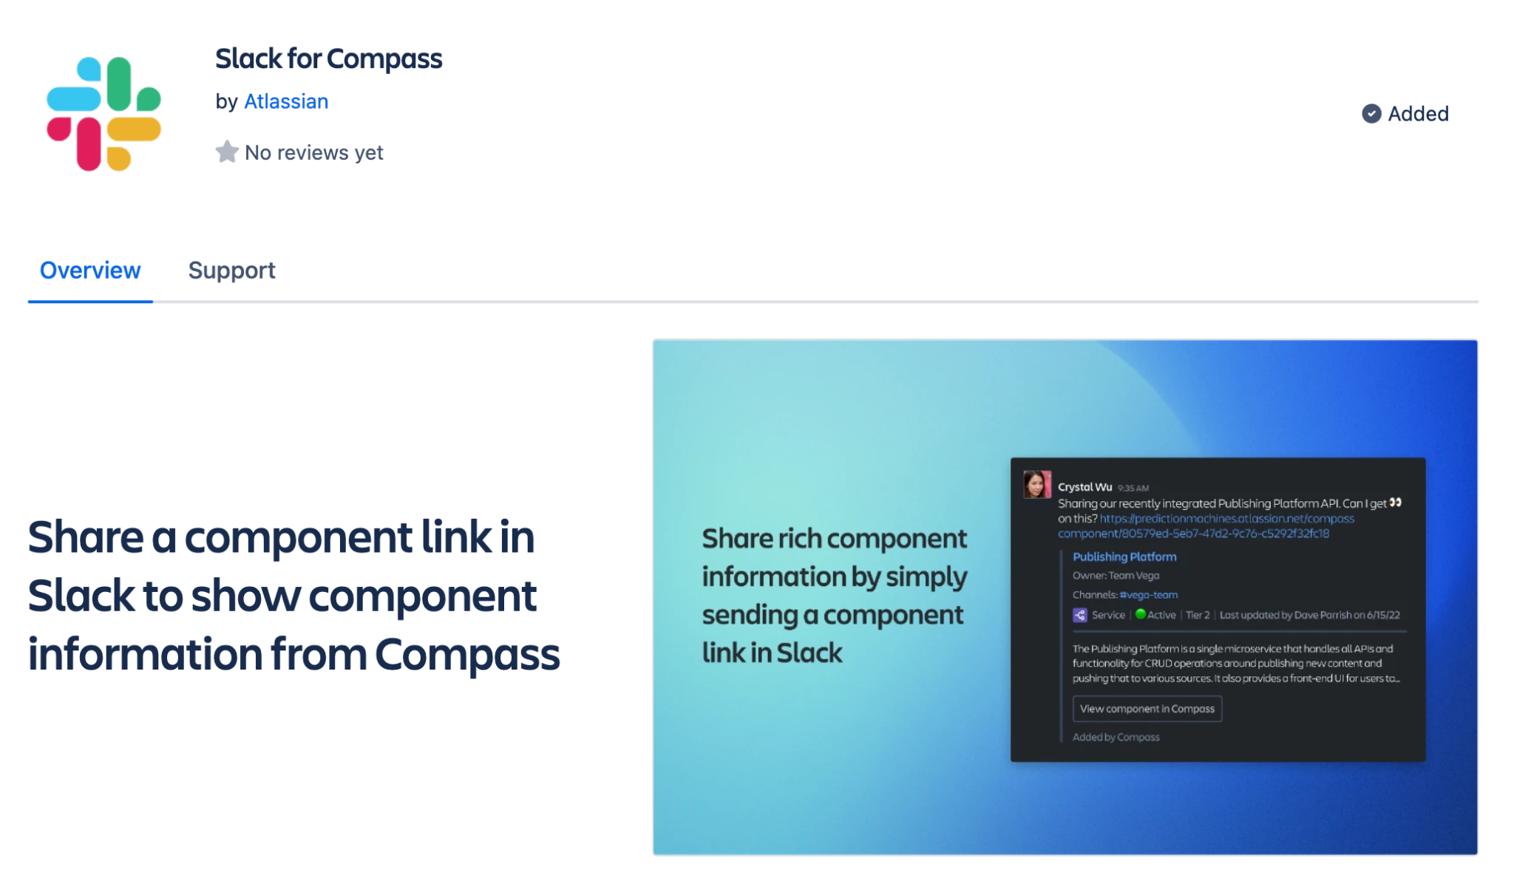
Integrate your favorite tools to reduce context switching
Notes:
Compass is fully extensible and built with open APIs, so teams have multiple ways to connect their entire toolchain and customize their Compass experience. We have a wide variety of apps available on the app marketplace, customers can easily build their own with the Forge platform.
Forge lets teams quickly build apps by simply wiring up the logic, and leave the infrastructure, provisioning, and storage to Atlassian.
Compass is great way to build custom tooling and roll it out across your entire organization.

Slide 20
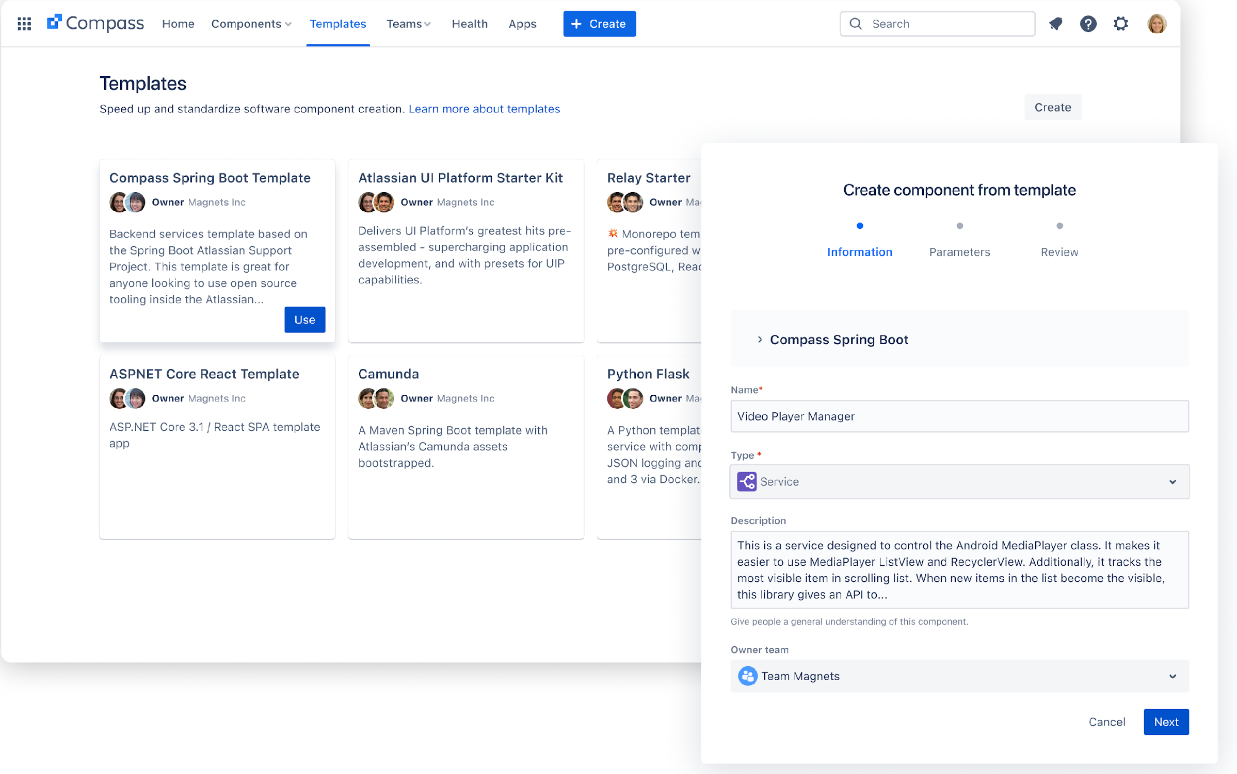
Automate consistency and accelerate paths
to production with software templates
Notes:
Finally, make the right way the easy way with Compass templates and shortcut lengthy processes.
Templates let organizations build golden paths for the developers with organizational standards and requirements baked in. That means less toil, better compliance, and reduced risk when creating a new service. Right now teams can use webhooks to create a new repo with boilerplate code included. Further development is planned on our roadmap.

Slide 21
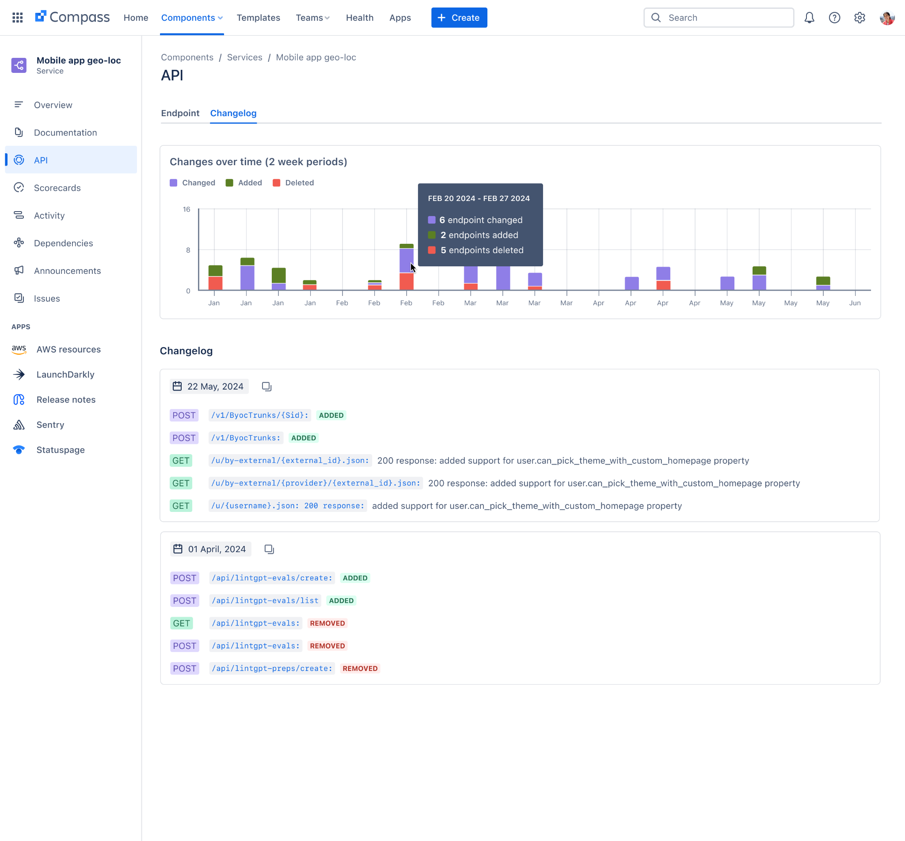
Automatically track API changes and keep documentation up to date with in Compass
Detect and organize API documentation:
Optic will find OpenAPI documentation in your code and publish it to Compass. When APIs change, their API consumers will get notifications within Compass.
Prevent breaking changes:
Makes sure developers have visibility of changes that affect them.
Notes:
Historically, keeping an up-to-date, searchable catalog of APIs is a massive internal effort. Compass makes it easy to centralize all your API documentation in an hour, not a week or a quarter. You don’t need to upload documentation manually every time you make a change, you just need to connect your SCM (Bitbucket, GitHub, or GitLab) to Compass.
Compass will scan all your repos for OpenAPI files and publish them to your catalog. That means all the APIs across all your teams become immediately centralized and searchable.
When developer have the documentation they need, code ships faster.

Slide 22

Benefits of a unified developer
experience platform
ROI = Time savings ×
# of engineers
Initial catalog setup
Decreased average time to first PR
Decreased time spent searching
Reduced MTTR
Prevented disruption time
Decreased time to deploy for a new service
Notes:
Compass is an investment that pays off for teams:
Decreased average time to first PR
Decreased time spent searching
Reduced MTTR
Prevented disruption time
Decreased time to deploy for a new service
We have resource available to help teams rollout Compass and measure impact. As part of that process, we recommend that teams take baseline measurements on time spent searching, and set goals to reduce it using Compass. This gives teams a clear picture of ROI with the time savings that Compass provides.

Slide 23


Get more value for your whole engineering org with Compass pricing
Free catalog for all!
As part of the Atlassian Cloud Platform, every Jira Software user can view catalog data as a basic user.
– Program/project managers
– Product managers
– Design
– Marketing/Business operations/Finance Legal
One low cost of $8/user for every engineer
Provide a better developer experience to your engineering org with advanced catalog capabilities, activity tracking, DORA metrics, health scorecards, software templates, integrations, and more as a full user.
– Developers
– Platform engineers
– Engineering managers
– ITOps engineers and support
Notes:
Now, more than ever, we believe it’s critical for every engineer in every organization to have access—without barriers—to the data they need to build and operate their software. Compass is always free to start, with one low price per user as you scale.
What are the benefits of having the free software component catalog?
Everyone in your organization gets the benefits of unified software component catalog - whether searching in Jira to see how component health impacts their sprint cycle or drilling down from Jira Service Management to find component details during an incident, they can access and collaborate within a single source of truth

Slide 24



Compass Pricing:
Three plans for organizations of all types
Free
$0 per user/month
Standard
$8 per user/month
Premium
$25 per user/month
For small teams who want to track their services in a unified catalog
Up to 3 standard users
Atlassian product integration
Default scorecards and metrics
Limited templates customization
Community support
30 days data retention
For teams looking to improve their developer experience and ops
Up to 35k standard users
Custom scorecards and metrics
Software templates
Marketplace apps
Advanced support and one-year of data retention
Alerts and on-call scheduling (coming soon)
For organizations looking to customize and scale their internal developer platform
Advanced configuration: permissions, IP allowlisting
Two years of data retention
99.99% uptime SLA and dedicated 24/7 support
Advanced alerts and on-call configuration and notifications (coming soon)
Free catalog for all, regardless of plan
Notes:
Compass is currently available in two plans: Free and Standard (paid), and the software component catalog is free regardless of plan so all customer to connect their repositories, libraries, APIs, and more, within one unified catalog that connects to teamwork data across all Atlassian Cloud products, giving you visibility across your entire software development lifecycle.
The Free plan is for small teams or individuals who want to get started tracking all of their software components and understanding their DevOps health in a single platform
The Standard plan is for every team ready to improve their developer experience, reduce cognitive load, and increase ops readiness at scale.
On both plans you can have unlimited free/$0 basic users that have view-only access to limited features. We generally recommend that a customer’s entire engineering org should be set up as full users, and other roles can generally start as basic users. Since pricing is flexible and scalable, some customers choose to start smaller with one team or organization and scale from their.
Soon we’ll be announcing our Premium plan for organizations that want to customize and scale their IDP at $25 per user per month. Compass Premium builds on Standard by adding:
Advanced configuration: RBAC and permissions, IP allowlisting
Two years of data retention
99.99% uptime SLA and 24/7 support
Advanced alerts and on-call configuration and notifications
Plus, additional enhancements like support for more templates and custom scorecards & metrics

Slide 25

Compass Premium
Advanced capabilities to drive organization-wide change and operate at scale
Permission Policies
Restrict access to critical actions to only those who need it
More Custom Objects
More templates, custom fields, custom scorecards, and custom metrics
IP Allowlisting
Bolster security by limiting your site access to trusted IP ranges (Available through Early Access Program)
Premium Support
24/7 premium support and 99.9% uptime SLA
2 Year Data Retention
Measure the impact of long-running projects across your organization
Coming Soon!
Custom component types, sandboxes, release tracks, and admin insights
Legend: Compass-specific Premium Premium Platform Premium Support
One simple price: $25 per user/month

Slide 26
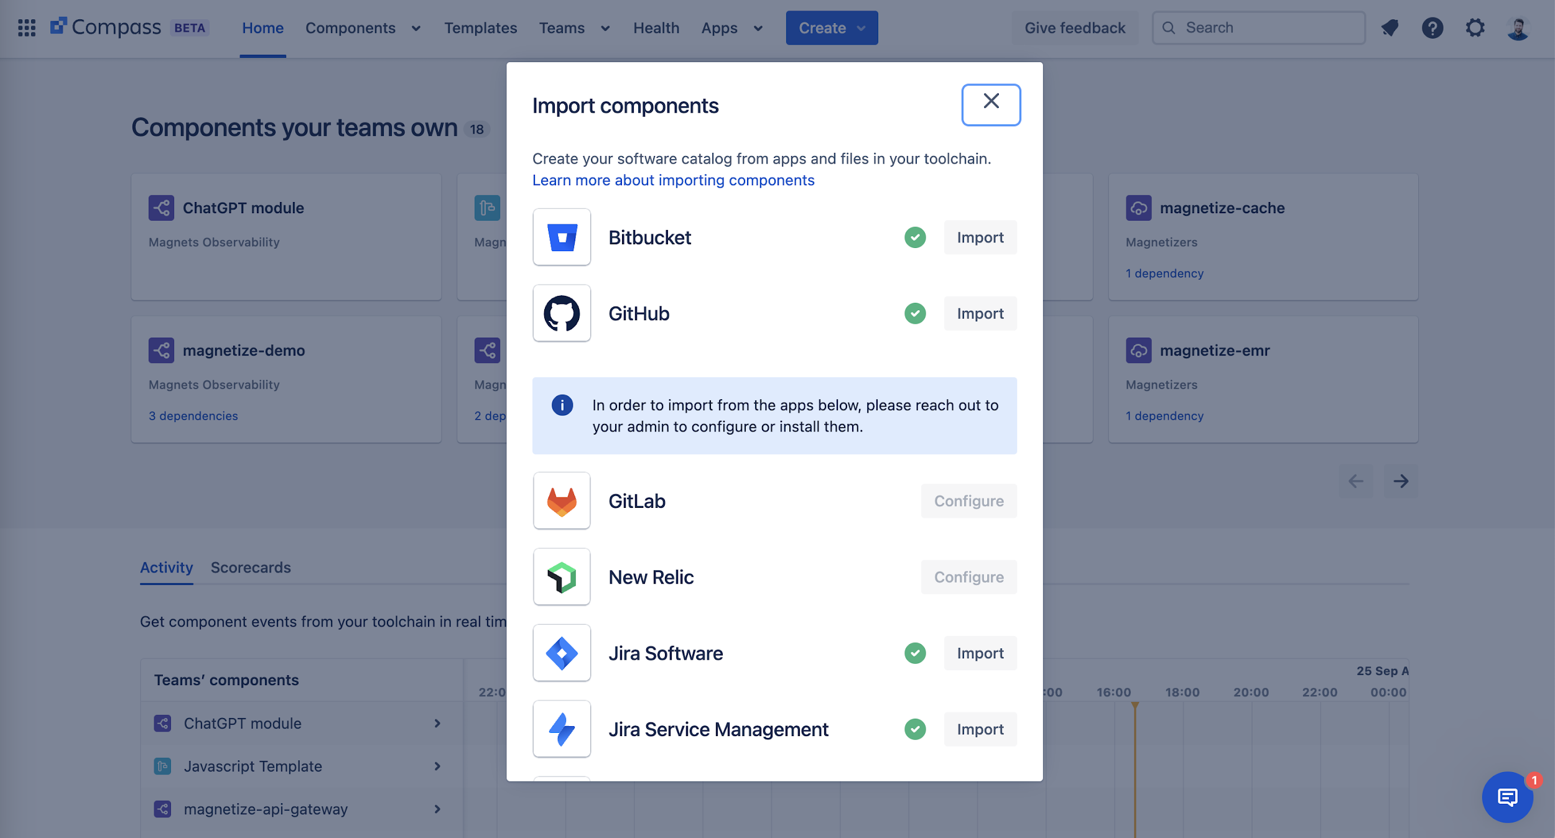
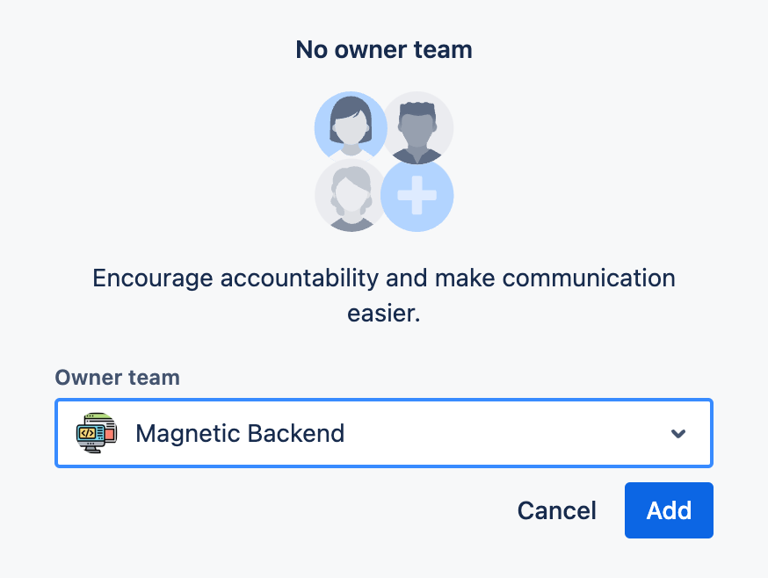
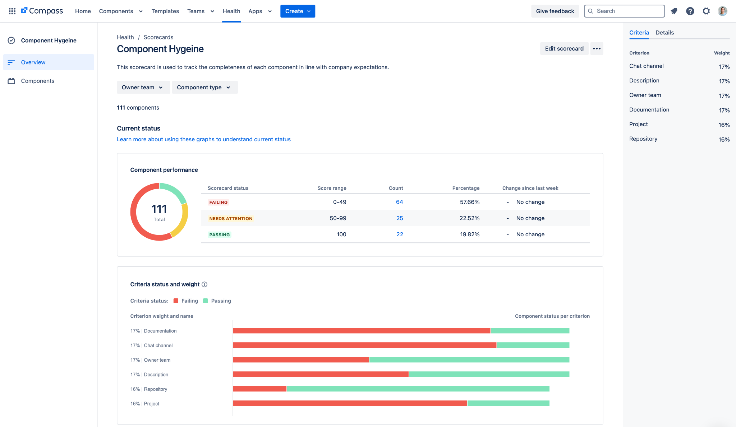
Getting started with Compass—the easy way
1. Setup software catalog and baseline DORA metrics
Connecting your SCM is the fastest way to get started and build a complete catalog
2. Assign software component ownership
Federated ownership speeds rollout focuses efforts on integration over data entry
3. Establish health scorecards and default templates
Transition existing engineering standards or governance into Compass and build into existing engineering rituals
Notes:
It’s quick and easy to get up and running. In just under 10 minutes, you can go from sign-up to fully populated software catalog by simply by connecting your source code management tool. We then recommend teams assign and claim ownernship of each component, and begin looking at Compass metrics and scorecards as part of their existing rituals and retrospectives. Over time, teams can build custom scorecards to track their standards and policies, and create templates to standardize the creation of new software componens.
This a great way to quickly launch a proof of concept, or for small teams and organizations.

Slide 27




We recommend a phased approach for organization-wide adoption
Compass is a powerful investment for improving developer experience
What our customer say: Get information out of engineers’ heads and into a centralized location
Building your software catalog and codefying standards in scorecards is the right place to start
After establishing good data hygiene and rituals, teams can customize their Compass experience with custom scorecards, templates, and extensibility
1. Planning
2. Design and Architecture
3. Compass Setup & Integration
4. Rollout
5. Continuous Improvement
Notes:
We have guides available to help organizations of all types and sizes implement Compass. This can generally be achieved quickly with small teams:
Batching on boarding and limiting to specific windows
Federate the updating of components to component owners
Track hygiene using scorecards which are communicated weekly.
The platform team's effort is more on the integration side rather than data entry.

Slide 28

Compass helps organizations
of all shapes and sizes

Slide 29





How Boden uses Compass
Boden is an online British clothing retailer with hundreds of services across six different engineering teams.
Challenge | Solution | Impact
Tracking service ownership and documentation: Boden’s developers found it difficult to understand which teams own a particular service or where the best documentation lived. Navigating knowledge silos: Engineering teams spent too much time asking and searching for information that should be accessible to all. | Internal developer platform: Boden turned to Compass for a “single pane of glass” - a centralized developer experience platform that provides full visibility into service details with relevant APIs, libraries, documentation, key health metrics, latest deployment activities, on-call schedules, and more. | More time coding and less time searching: Developers are empowered to self-serve and make smart decisions with Compass. Reduce cognitive load: Developers can easily find what they need, when they need it. Hundreds of services owned by six teams are captured in one component catalog with Compass.
Hear from James Crowe, Head of Software Engineering at Boden here.
Notes:
Sources
Customer Marketing Team '24 Europe content bank: https://hello.atlassian.net/l/cp/P21DtH5F
DevEx Platform Solution Deep Dive: https://hello.atlassian.net/wiki/spaces/ASF1/pages/3844738787/DevEx+Platform+Solution+Deep+Dive
How Boden uses Compass | Atlassian Presents: Unleash | Atlassian: https://www.youtube.com/watch?v=qqao4QXLURY&t=2s&pp=ygUPYm9kZW4gYXRsYXNzaWFu
Achieving world-class developer experience (OVO): https://events.atlassian.com/team-digital/v/s-2154606?i=HifNitq6DMwslp10ZXx_zDyqHGt5I49R

Slide 30

How OVO uses Compass
OVO Energy is a major energy supplier for millions of home across the UK.
Challenge | Solution | Impact
Proliferation of microservices: OVO Energy made several acquisitions in a short period of time. New people brought in new services stored in clunky systems, spreadsheets, personal docs, etc. Developer friction: Engineering teams spent more time on Slack asking for help than coding because they lacked a central source of truth for all their software component data. | Internal developer platform: With Compass, OVO Energy was able to democratize service data to everyone who needed it with the right data, context and access. Atlassian ecosystem: OVO Energy reduced tool sprawl by using Compass and linking in to other parts of the Atlassian suite, such as OpsGenie and Statuspage. | Less context switching: Developers have all of the information they need in one place with Compass. OVO engineering teams were able save time and energy by locating the service data or documentation they needed within seconds in the software component catalog. Keep developers in the flow, on Atlassian: Developers can easily hook in other Atlassian Cloud products.
Hear from Liz Watkins, IT Service Operations Manager at OVO Energy here (29:40).

Slide 31

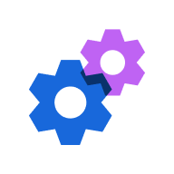

Roadmap: Looking ahead
AI Native Search
Find what you’re looking for in seconds
Automatic Updates
Keep docs, tickets, and operational information in sync across all Atlassian products
Alerts and On-call in Compass
Context-rich alerting and on-call scheduling for devs
Templates and Automation
Make the right way, the easy way
** Atlassian Confidential **
Notes:
Here’s an overview of our roadmap. In October, we’re releasing Compass Premium with enterprise-grade features. Streamlining catalog create and robust search are also on the way. We’ll also be improving Compass scorecards and templating.

Slide 33
Appendix

Slide 34

Where developer experience fits in
Top-level priority for engineering orgs
78% of enterprises have a formal DevEx initiative
58% of enterprises report developer experience as “very” or “extremely” critical to the C-suite
86% of enterprises will have a dedicated platform team focused on delivering reusable services to devs by 2026
42% of dev time is spent on inefficiencies (bad code, tech debt, etc)
Sources: Gartner, 2023 survey; Stripe “The Developer Coefficient,” 2018

